Slide 1
The Tragedy of your Upstairs Neighbors:
When is the Home-Sharing Externality Internalized?
Apostolos Filippas NYU Stern
John Horton NYU Stern

Slide 2
This paper
Considers some public policy options to deal with often-leveled critique against home-sharing
Finds that policies that allow building owners---but not individual tenants or cities---to set policy are socially efficient
Also contains:
  empirical investigation of key modeling assumptions
  simulations of the market to investigate considerations not captured in the simple model

Slide 3
Policy issues raised by home-sharing
Home-sharing platforms facilitate racial discrimination
  Edelman et al. 2017
`
■
■
Home-sharing raises long-term rents by removing supply
  Sheppard & Udell 2016
Home-sharing directly imposes costs on neighbors
  This paper
■
■

Slide 4



Neighbors
Guest
Owner
$ $
$ $

Slide 5
Home-sharing as a negative externality
Hosts impose a cost on their neighbors
  hosts get the money, guests get the noise/risk/parties/...
Similar to classic cases of un-internalized externalities
  pollution, overfishing, speeding while driving
There is "too much" of the activity in equilibrium
  in practice, negative externalities solved with public policy
■
■
■
■

Slide 6




What happens when the decision is made by:
Individual tenants
Building owners
City government
Benevolent social planner

Slide 7
Our analytic approach
Allocate hosting decision rights to:
{individuals, building owners, city, social planner}
Determine the resulting market equilibrium
Characterize the welfare properties of that equilibrium
i.
ii.
i.
ii. iii.

Slide 8





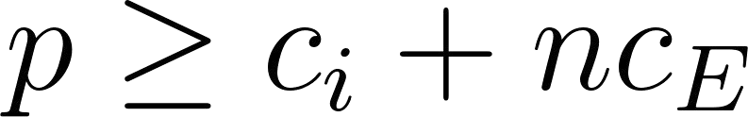
Some definitions
The going price for a home-sharing stay is
  price is endogenous: decreasing in number of hosts
Tenant/host has hosting cost
The tenant/host has neighbors in the building
A guest imposes a cost of on every neighbor
An additional listing is (socially) efficient so long as
■
■
■
■

Slide 9

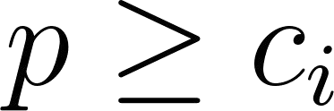
The four regimes
Host if
Set building-wide policies
Care only about profits from long-term rents
Centrally adjusts supply Cares only about tenants
Centrally adjusts supply
Cares about tenants and guests
9

Slide 10

Market equilibrating process
Set policies
Move to the
Host if
Price updated
"right" building
Costlessly
(we will relax this later)

Slide 11
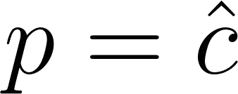
Tenants-Decide (TD) regime
Laissez-faire
  tenants are free to decide whether to host or not
The "marginal" tenant who hosts, has hosting cost equal to the market price
○
This is inefficient → there is too much hosting.
■
■
■
■

Slide 12
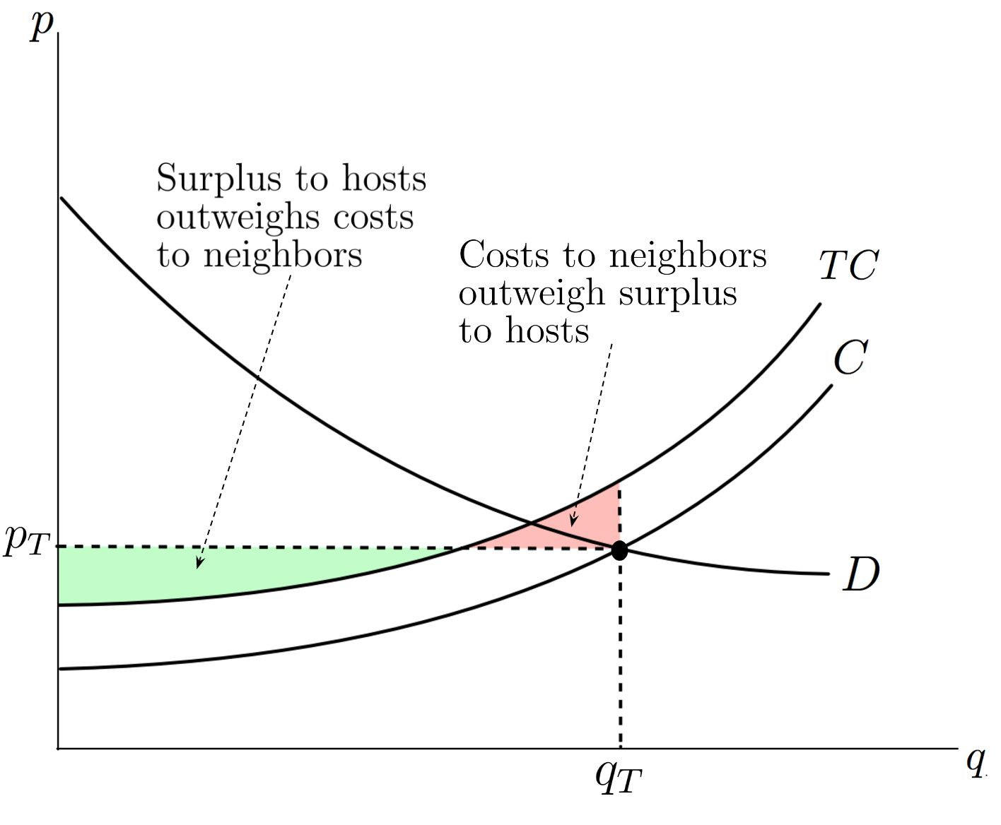
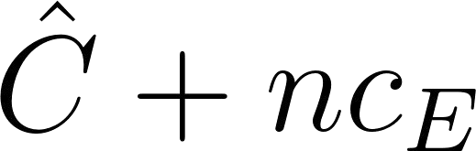

Tenants-Decide regime
Inefficiently high amount of hosting
Tenant welfare ↘
(potentially)
●

Slide 13


TD regime - externalities
Externalities are not internalized

Slide 14
"City decides" (CD) regime
The City decides on a home-sharing quantity
The City only cares about residents’ welfare
  behaves like a monopolist
There is too little hosting
■
■
■
■

Slide 15
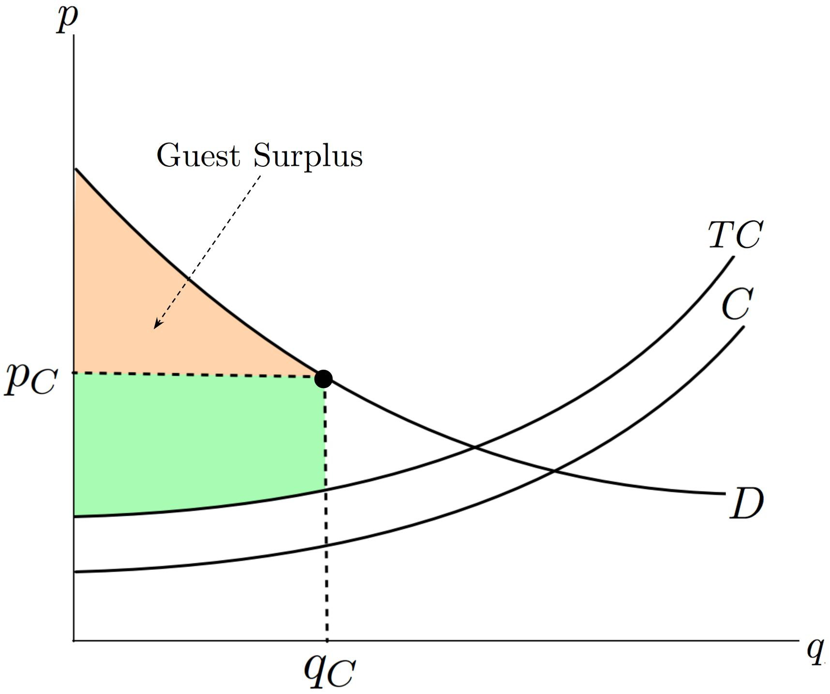
"City decides" regime
Host welfare ↗
(optimal)
Social welfare ↗
(but not optimal)
○

Slide 16
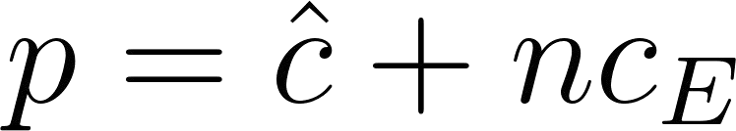
"Building owners" (BD) decide
Building owners
  only care about profits from long-term rentals
  set a blanket policy for the entire building
In equilibrium:
  owners are indifferent between costless policies → no premium "no policy arbitrage"
  marginal host indifferent between hosting bldg and non-hosting bldg on basis of hosting costs and benefits (rents are the same), and so:
■
■

Slide 17
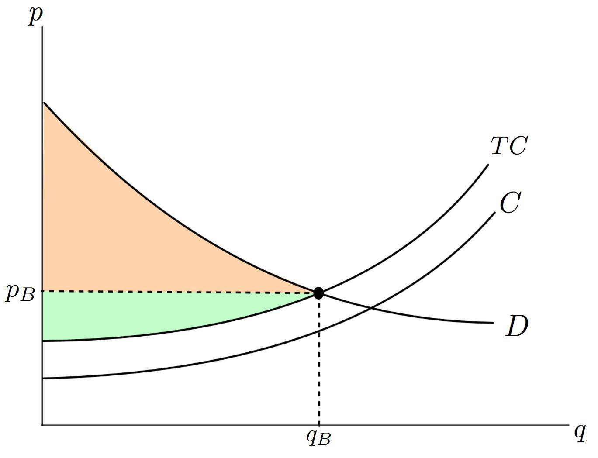
"Building owners" decide
Socially optimal amount of hosting
Tenant welfare ↗
(always)
●

Slide 18


BD regime - externalities
Externalities internalized

Slide 19
Empirical portion of the paper
Assess the "no policy arbitrage" assumption using apartment rental listings in NYC
Uses the building owner decision regarding subletting as a proxy for home-sharing
Key result: No evidence of arbitrage opportunities, consistent with our modeling assumptions

Slide 20
Thank you
Paper Title:
The Tragedy of Your Upstairs Neighbors:
Is the Home-Sharing Externality Internalized?
Authors:
Apostolos Filippas and John Horton
Draft:
http://www.john-joseph-horton.com/papers/airbnb.pdf
20

Slide 21



Uber Might Buy Me a Mercedes Benz:
An Empirical Investigation of Ridesharing Platforms and Durable Goods Purchase
Brad N Greenwood
Co-Authored with Jing Gong (Temple) and Yiping Song (Fudan)
Boston University Platforms Symposium
July 2017

Slide 22
What I Hope You Remember
We investigate how the entry of gig-economy platforms influences durable goods purchase.
Results suggest
  After the entry of these platforms purchases rise significantly
  There are interesting differences across age and gender

Slide 23
What I Hope You Remember
We investigate how the entry of gig-economy platforms influences durable goods purchase.
Results suggest
  After the entry of these platforms purchases rise significantly
  There are interesting differences across age and gender
Economically
  8% increase in vehicle purchase in treated locations
Implications and Contributions
  Open up a question of considerable analytical interest
  Broader lit on our understanding of the supply side of the sharing economy
  Implications for manufacturers and financiers

Slide 24






Platforms in the digital age

Slide 25


Platforms in the digital age

Slide 26


Platforms in the digital age

Slide 27
What do we know about platforms and the gig-economy?
Roughly $26 billion market (Malhotra and Van Alstyne 2014)
  Projected to grow to $335B by 2025 (PWC, 2016)
Research has progressed on many fronts:
  Increased access to goods (Einav et al. 2016)
  Strategic changes in the behavior of incumbent firms (Seamans and Zhu 2011, Zervas et al. 2017)
  Increased efficiency and asset utilization (Cramer and Krueger 2016)
  Improved public safety (Greenwood and Wattal 2017)

Slide 28
What do we know about platforms and the gig-economy?
Roughly $26 billion market (Malhotra and Van Alstyne 2014)
  Projected to grow to $335B by 2025 (PWC, 2016)
Research has progressed on many fronts:
  Increased access to goods (Einav et al. 2016)
  Strategic changes in the behavior of incumbent firms (Seamans and Zhu 2011, Zervas et al. 2017)
  Increased efficiency and asset utilization (Cramer and Krueger 2016)
  Improved public safety (Greenwood and Wattal 2017)
Most research suggests that the service economy is price sensitive and displacing lower tier competitors
  Hotels (Zervas et al, 2015)
  Price sensitivity in drunk driving (Greenwood and Wattal, 2015)

Slide 29

But what do we not know?
Most research has focused on the demand side
Limited empirical focus on the supply side
  Racial bias and AirBNB (Edelman and Luca, 2014)
  Surveys of participants (Hall and Krueger 2015)
  Changing access to job opportunities (Burtch et al. 2017)
  Peer to peer lending markets (Morse, 2015)
We investigate the means by which people participate in these platforms, and if their actions are strategic

Slide 30


But what do we not know?
Most research has focused on the demand side
Limited empirical focus on the supply side
  Racial bias and AirBNB (Edelman and Luca, 2014)
  Surveys of participants (Hall and Krueger 2015)
  Changing access to job opportunities (Burtch et al. 2017)
  Peer to peer lending markets (Morse, 2015)
We investigate the means by which people participate in these platforms, and if their actions are strategic

Slide 31


Research Question
What is the effect of sharing economy platform introduction on durable goods purchase?

Slide 32

Why might these platforms affect purchase?
The analytical literature suggests two opposing forces may be at play:
  Cannibalization effect (Jiang and Tian 2016)
  Value enhancement effect (Abhishek et al. 2016)
These forces create a natural tension

Slide 33

Cannibalizing Purchases?!?
Ridesharing platforms…
  Provide efficient and low-cost transportation options (Cramer and Krueger 2016, Greenwood and Wattal 2017)
Thus, the platform may reduce a consumers’ propensity to own and make durable goods purchases (Abhishek et al. 2016, Fraiberger and Sundararajan 2015, Horton and Zeckhauser 2016, Jiang and Tian 2016)

Slide 34
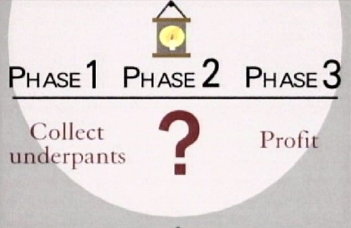
But Value Enhancement might happen?
As such platforms imbue owners the possibility of sharing excess capacity with others
  Additional income (Burtch et al. 2017)
This may increase their propensity to make durable goods purchases by defraying the cost through the platform (Abhishek et al. 2016, Fraiberger and Sundararajan 2015, Horton and Zeckhauser 2016, Jiang and Tian 2016)

Slide 35

So what is going to happen?
If people are no longer purchasing vehicles because the ridesharing apps afford them an efficient means of transportation, purchasing may fall.
If people see the platform as a means to capture additional rents, or defray the cost of ownership, purchasing may rise.

Slide 36

The Setting
A Natural Experiment
  The entry of the ridesharing platform, People’s Uber, into different cities in China
  To a large degree this is the Chinese equivalent of Uber X
Experimental Validity
  Entry is geographically and temporally disbursed
  Entry data from Uber’s official blog and Weibo
    Different from DiDi and others
  The dominant service until the sale to DiDi Chuxing

Slide 37
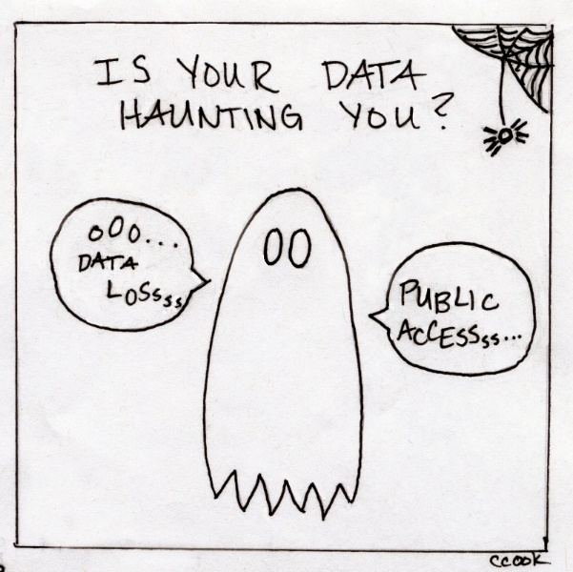
Data
Vehicle Purchase Data
  Longitudinal data set that contains new car registrations in China from 2010 to 2015 inclusive
  Exclude all cities with a
  registration auction
Observation –
Prefecture/Month
  1008 observations
  72-months
  14 Cities

Slide 38
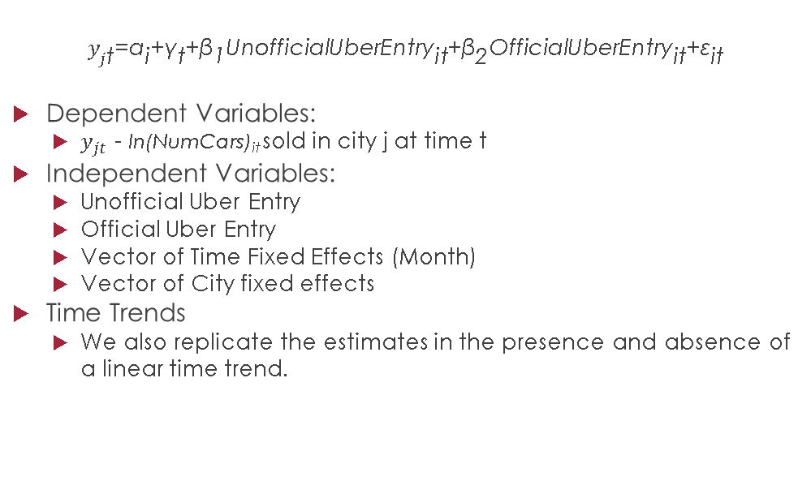
Variable Definitions and Estimator
$$y_{j\text{t}}\text{=}{\text{α}}_{\text{i}}\text{+}{\text{γ}}_{\text{t}}\text{+}{\text{β}}_{\text{1}}\text{UnofficialUberEntr}{\text{y}}_{\text{it}}\text{+}{\text{β}}_{\text{2}}{\text{OfficialUberEntry}}_{\text{it}}\text{+}{\text{ε}}_{\text{it}}$$
Dependent Variables:
  $y_{jt}$ - ln(NumCars)_{it} sold in city j at time t
Independent Variables:
  Unofficial Uber Entry
  Official Uber Entry
  Vector of Time Fixed Effects (Month)
  Vector of City fixed effects
Time Trends
  We also replicate the estimates in the presence and absence of a linear time trend.

Slide 39
Difference in difference
 | (1) | (2)
Dependent Variable | ln(NumCars) | ln(NumCars)
Unofficial Uber Entry | 0.180 | 0.000
 | (0.143) | (0.0837)
Official Uber Entry | 0.217** | 0.0820*
 | (0.0788) | (0.0429)
Observations | 1,008 | 1,008
R-squared | 0.798 | 0.850
Month FE | Yes | Yes
City FE | Yes | Yes
City trend | No | Linear
Note: Robust standard errors clustered at city level in parentheses. *** p<0.01, ** p<0.05, * p<0.1

Slide 40

Robustness Checks
Marshall does not believe our results
Come see the poster for the wide world of robustness checks
I am smiling because you are so wrong!

Slide 41


Reputation, Risk, and Contribution Quality in Q & A communities
Platform Symposium, July 13, 2017
Chris Dellarocas, Boston university
Ted Lappas, stevens institute of technology
NEDA DERAKHSHANi, boston university

Slide 42
Motivation
Reputation mechanisms have been widely used to regulate and sort user behavior in platforms

Slide 43
Motivation
Reputation mechanisms have been widely used to regulate and sort user behavior in platforms
How do such mechanisms affect the evolution of user participation over time?

Slide 44

Motivation
Reputation mechanisms have been widely used to regulate and sort user behavior in platforms
How do such mechanisms affect the evolution of user participation over time?
Study context: Stackoverflow, one of the most successful Q&A communities

Slide 45
Our Research Questions
How does Q&A user behavior evolve as their reputation grows?
Do users take risks by going after harder questions?
How is their answering performance affected?

Slide 46
Our Research Questions
How does Q&A user behavior evolve as their reputation grows?
Do users take risks by going after harder questions?
How is their answering performance affected?
Data Set
  18 million responses to 9.8 million questions that were posted on StackOverflow between July 31, 2008 and August 6, 2016
  Text, Responses, Timestamps, Votes, Views, User info, ...
  Rich panel dataset includes the full history of each community member

Slide 47
Main Findings
Higher ability → harder questions BUT
  ceteris paribus, higher reputation makes users increasingly risk averse
  Explanation: Fear of losing one’s reputation; diminishing returns from trying hard
When a user attempts to tackle questions that surpass her ability level → worse performance
  Effect is worse the higher one’s reputation
  Explanation: Overconfidence leads to lower performance

Slide 48
Main Findings
Higher ability → harder questions BUT
  ceteris paribus, higher reputation makes users increasingly risk averse
  Explanation: Fear of losing one’s reputation; diminishing returns from trying hard
When a user attempts to tackle questions that surpass her ability level → worse performance
  Effect is worse the higher one’s reputation
  Explanation: Overconfidence leads to lower performance

Slide 49
Main Findings
Higher ability → harder questions BUT
  ceteris paribus, higher reputation makes users increasingly risk averse
  Explanation: Fear of losing one’s reputation; diminishing returns from trying hard
When a user attempts to tackle questions that surpass her ability level → worse performance
  Effect is worse the higher one’s reputation
  Explanation: Overconfidence leads to lower performance

Slide 50
Main Findings
Higher ability → harder questions BUT
  ceteris paribus, higher reputation makes users increasingly risk averse
  Explanation: Fear of losing one’s reputation; diminishing returns from trying hard
When a user attempts to tackle questions that surpass her ability level → worse performance
  Effect is worse the higher one’s reputation
  Explanation: Overconfidence leads to lower performance

Slide 51
Methodological contribution:
Assessing user ability and question difficulty
Ability ≠ Reputation
Users are more likely to be of high ability if they submit good answers to questions submitted by other high ability users
  i.e. if their answers are endorsed by other high ability users
How to estimate:
  Create an acceptance graph: graph of all users where
    Link from i to j → user i accepts a response submitted by j to one of her questions
  Apply an algorithm akin to pagerank to estimate user abilities
Question difficulty = Asker’s ability
  Intuition: A question that perplexes an expert is more likely to be difficult

Slide 52
Methodological contribution:
Assessing user ability and question difficulty
Ability ≠ Reputation
Users are more likely to be of high ability if they submit good answers to questions submitted by other high ability users
  i.e. if their answers are endorsed by other high ability users
How to estimate:
  Create an acceptance graph: graph of all users where
    Link from i to j → user i accepts a response submitted by j to one of her questions
  Apply an algorithm akin to pagerank to estimate user abilities
Question difficulty = Asker’s ability
  Intuition: A question that perplexes an expert is more likely to be difficult

Slide 53
Methodological contribution:
Assessing user ability and question difficulty
Ability ≠ Reputation
Users are more likely to be of high ability if they submit good answers to questions submitted by other high ability users
  i.e. if their answers are endorsed by other high ability users
How to estimate:
  Create an acceptance graph: graph of all users where
    Link from i to j → user i accepts a response submitted by j to one of her questions
  Apply an algorithm akin to pagerank to estimate user abilities
Question difficulty = Asker’s ability
  Intuition: A question that perplexes an expert is more likely to be difficult

Slide 54
Methodological contribution:
Assessing user ability and question difficulty
Ability ≠ Reputation
Users are more likely to be of high ability if they submit good answers to questions submitted by other high ability users
  i.e. if their answers are endorsed by other high ability users
How to estimate:
  Create an acceptance graph: graph of all users where
    Link from i to j → user i accepts a response submitted by j to one of her questions
  Apply an algorithm akin to pagerank to estimate user abilities
Question difficulty = Asker’s ability
  Intuition: A question that perplexes an expert is more likely to be difficult

Slide 55
Methodological contribution:
Assessing user ability and question difficulty
Ability ≠ Reputation
Users are more likely to be of high ability if they submit good answers to questions submitted by other high ability users
  i.e. if their answers are endorsed by other high ability users
How to estimate:
  Create an acceptance graph: graph of all users where
    Link from i to j → user i accepts a response submitted by j to one of her questions
  Apply an algorithm akin to pagerank to estimate user abilities
Question difficulty = Asker’s ability
  Intuition: A question that perplexes an expert is more likely to be difficult

Slide 56
Implications for platform design
Reputation reduces user interest in tackling hard tasks
  Potential interventions:
  Attach higher rewards to harder tasks
  Make rewards a function of user reputation
  Endow high reputation users with ‘forgiveness’ points
Reputation decreases user performance when tackling hard tasks
  Potential interventions:
  Factor the 3-way interaction of user ability, user reputation, and question difficulty into personalized task recommendations to users

Slide 57
Implications for platform design
Reputation reduces user interest in tackling hard tasks
  Potential interventions:
  Attach higher rewards to harder tasks
  Make rewards a function of user reputation
  Endow high reputation users with ‘forgiveness’ points
Reputation decreases user performance when tackling hard tasks
  Potential interventions:
  Factor the 3-way interaction of user ability, user reputation, and question difficulty into personalized task recommendations to users

Slide 58
Implications for platform design
Reputation reduces user interest in tackling hard tasks
  Potential interventions:
  Attach higher rewards to harder tasks
  Make rewards a function of user reputation
  Endow high reputation users with ‘forgiveness’ points
Reputation decreases user performance when tackling hard tasks
  Potential interventions:
  Factor the 3-way interaction of user ability, user reputation, and question difficulty into personalized task recommendations to users

Slide 59
Implications for platform design
Reputation reduces user interest in tackling hard tasks
  Potential interventions:
  Attach higher rewards to harder tasks
  Make rewards a function of user reputation
  Endow high reputation users with ‘forgiveness’ points
Reputation decreases user performance when tackling hard tasks
  Potential interventions:
  Factor the 3-way interaction of user ability, user reputation, and question difficulty into personalized task recommendations to users

Slide 60

Full paper available at SSRN
Reputation and Contribution in Online Question-Answering Communities
https://ssrn.com/abstract=2918913

Slide 61

Intra-platform Envelopment:
The Coopetitive Dynamics between Platform Owners and Platform Complementors
Hye Young Kang
This research is supported by Kauffman Dissertation Fellowship and Strategic Research Foundation Dissertation Grant

Slide 62



PRIOR RESEARCH FOCUSES LARGELY ON PLATFORM OWNERS

Slide 63

PLATFORM OWNER-COMPLEMENTOR RELATIONSHIP HAS BEEN MAINLY CONCEPTUALIZED AS COOPERATIVE
Notes:
Note: Yet, given such a heavy focus on inter-platform competition (that is, competition between different platform owners), the relationship between platform owner and its complementors has been largely presumed as complementary or cooperative. That is mainly because,
For platform owners, in order to win against other competing platform owners, it is critical for them to have an active and committed support/participation from complementors, because they can attract more consumers via indirect network effects
Also, for platform complementors, the platform owner presents the access to large markets and audience
However, competition can also emerge even within the platform setting, ranging from the platform owner’s regulating its platform participants to a more direct intervention of the owner’s entering the market space of platform complementors, which I denote here as “intra-platform envelopment”, and this is a key topic of this presentation.
As such, despite the fact that the relationship between the platform owner and complementors is “coopetitive”, considering a heavier focus on cooperative aspect, coopetitive dynamics within the setting of the platform has been little unpacked. Thus, as part of the efforts to unpack this, I conceptualize “intra-platform envelopment”

Slide 64

BUT, OWNERS CAN ALSO COMPETE WITH THEIR COMPLEMENTORS
Notes:
Note: Yet, given such a heavy focus on inter-platform competition (that is, competition between different platform owners), the relationship between platform owner and its complementors has been largely presumed as complementary or cooperative. That is mainly because,
For platform owners, in order to win against other competing platform owners, it is critical for them to have an active and committed support/participation from complementors, because they can attract more consumers via indirect network effects
Also, for platform complementors, the platform owner presents the access to large markets and audience
However, competition can also emerge even within the platform setting, ranging from the platform owner’s regulating its platform participants to a more direct intervention of the owner’s entering the market space of platform complementors, which I denote here as “intra-platform envelopment”, and this is a key topic of this presentation.
As such, despite the fact that the relationship between the platform owner and complementors is “coopetitive”, considering a heavier focus on cooperative aspect, coopetitive dynamics within the setting of the platform has been little unpacked. Thus, as part of the efforts to unpack this, I conceptualize “intra-platform envelopment”

Slide 65




(INTER-) PLATFORM ENVELOPMENT (Eisenmann, Parker, and Van Alstyne, 2011)
Notes:
‘Platform envelopment’ , introduced by Eisenmann, Parker, and Van Alstyne in 2011, is one of the most prominent entry strategies in platform versus platform battle.
Platform envelopment is a platform owner’s bundling the features or functionalities, which are already offered by another platform owner.
Yet, such envelopment action has not been conceptualized or explicitly been delved into in within-the-platform setting.
Thus, I extend this notion into within-the-platform setting, and conceptualize “intra-platform envelopment”
This is important, and intra-platform envelopment is, intrinsically, different from platform envelopment, considering tight, close interdependence between the platform owner and platform complementors. A full, product cloning, a very obvious frontal attack, is less likely to emerge; rather, intra-platform envelopment is likely to be done in a delicate or subtle manner; e.g., partial overlapping of some features or functionalities. My conceptualization allows/incorporates this varying degree of envelopment, and to do so, I focus on the features or functionalities of the product (instead of product per se)

Slide 66


INTRA-PLATFORM ENVELOPMENT
Notes:
‘Platform envelopment’ , introduced by Eisenmann, Parker, and Van Alstyne in 2011, is one of the most prominent entry strategies in platform versus platform battle.
Platform envelopment is a platform owner’s bundling the features or functionalities, which are already offered by another platform owner.
Yet, such envelopment action has not been conceptualized or explicitly been delved into in within-the-platform setting.
Thus, I extend this notion into within-the-platform setting, and conceptualize “intra-platform envelopment”
This is important, and intra-platform envelopment is, intrinsically, different from platform envelopment, considering tight, close interdependence between the platform owner and platform complementors. A full, product cloning, a very obvious frontal attack, is less likely to emerge; rather, intra-platform envelopment is likely to be done in a delicate or subtle manner; e.g., partial overlapping of some features or functionalities. My conceptualization allows/incorporates this varying degree of envelopment, and to do so, I focus on the features or functionalities of the product (instead of product per se)

Slide 67

INTRA-PLATFORM ENVELOPMENT (IPE)
Other related concepts | How is IPE different?
(Inter-) Platform envelopment | High level of interdependence
Vertical integration | Complementors suppliers; 6th industry force
Finer-grained analysis at the product feature level

Slide 68
INTRA-PLATFORM ENVELOPMENT (IPE)
Other related concepts | How is IPE different?
(Inter-) Platform envelopment | High level of interdependence
Vertical integration | Complementors suppliers; 6th industry force
Finer-grained analysis at the product feature level

Slide 69

ONE MIGHT IMAGINE POSITIVE SPILLOVER EFFECTS OF INTRA-PLATFORM ENVELOPMENT
Notes:
‘Platform envelopment’ , introduced by Eisenmann, Parker, and Van Alstyne in 2011, is one of the most prominent entry strategies in platform versus platform battle.
Platform envelopment is a platform owner’s bundling the features or functionalities, which are already offered by another platform owner.
Yet, such envelopment action has not been conceptualized or explicitly been delved into in within-the-platform setting.
Thus, I extend this notion into within-the-platform setting, and conceptualize “intra-platform envelopment”
This is important, and intra-platform envelopment is, intrinsically, different from platform envelopment, considering tight, close interdependence between the platform owner and platform complementors. A full, product cloning, a very obvious frontal attack, is less likely to emerge; rather, intra-platform envelopment is likely to be done in a delicate or subtle manner; e.g., partial overlapping of some features or functionalities. My conceptualization allows/incorporates this varying degree of envelopment, and to do so, I focus on the features or functionalities of the product (instead of product per se)

Slide 70

YET, IN GENERAL, WE SHOULD EXPECT NEGATIVE, COMPETITIVE EFFECTS OF INTRA-PLATFORM ENVELOPMENT
Notes:
‘Platform envelopment’ , introduced by Eisenmann, Parker, and Van Alstyne in 2011, is one of the most prominent entry strategies in platform versus platform battle.
Platform envelopment is a platform owner’s bundling the features or functionalities, which are already offered by another platform owner.
Yet, such envelopment action has not been conceptualized or explicitly been delved into in within-the-platform setting.
Thus, I extend this notion into within-the-platform setting, and conceptualize “intra-platform envelopment”
This is important, and intra-platform envelopment is, intrinsically, different from platform envelopment, considering tight, close interdependence between the platform owner and platform complementors. A full, product cloning, a very obvious frontal attack, is less likely to emerge; rather, intra-platform envelopment is likely to be done in a delicate or subtle manner; e.g., partial overlapping of some features or functionalities. My conceptualization allows/incorporates this varying degree of envelopment, and to do so, I focus on the features or functionalities of the product (instead of product per se)

Slide 71


HOWEVER, NOT ALL PLATFORMS ARE THE SAME
Notes:
‘Platform envelopment’ , introduced by Eisenmann, Parker, and Van Alstyne in 2011, is one of the most prominent entry strategies in platform versus platform battle.
Platform envelopment is a platform owner’s bundling the features or functionalities, which are already offered by another platform owner.
Yet, such envelopment action has not been conceptualized or explicitly been delved into in within-the-platform setting.
Thus, I extend this notion into within-the-platform setting, and conceptualize “intra-platform envelopment”
This is important, and intra-platform envelopment is, intrinsically, different from platform envelopment, considering tight, close interdependence between the platform owner and platform complementors. A full, product cloning, a very obvious frontal attack, is less likely to emerge; rather, intra-platform envelopment is likely to be done in a delicate or subtle manner; e.g., partial overlapping of some features or functionalities. My conceptualization allows/incorporates this varying degree of envelopment, and to do so, I focus on the features or functionalities of the product (instead of product per se)

Slide 72



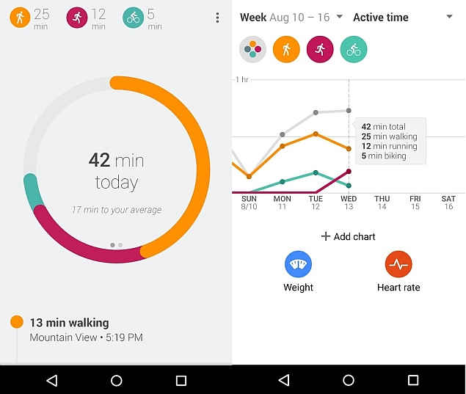
HEALTH & FITNESS MOBILE APPS
Apple Health
Google Fit
Notes:
I empirically test this intra-platform envelopment in the context of two leading mobile platforms, Apple and Google, and particularly, centering around two important events that affect H&F category,
Salient examples of intra-platform envelopment in H&F category is the platform owners in both app stores launching their own apps
App
API
Offer “Tracking” feature, which has already offered by some of the existing third-party H&F apps

Slide 73
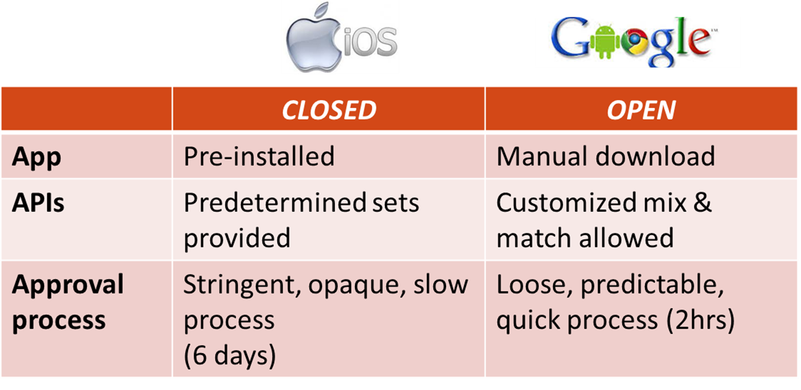
“CLOSED” APPLE VS. “OPEN” GOOGLE

Slide 74




DIFFERENCE-IN-DIFFERENCES APPROACH
Intra-platform envelopment
BEFORE
AFTER
App T: whose subcategory is enveloped by the platform owner
Treated: whose subcategory is enveloped by platform owner
App C: whose subcategory is not enveloped by the platform owner
Controls: whose subcategory is not enveloped by platform owner
Notes:
H&F apps can be further subcategorized based on it primary focus of business.
By exploiting the fact that Apple Health and Google Fit (intra-platform envelopment in H&F category) does not affect all the H&F apps in the same manner; that is, timing of envelopment differ by this subcategory, I grouped H&F apps in to two; treated and control, by subcategory

Slide 75
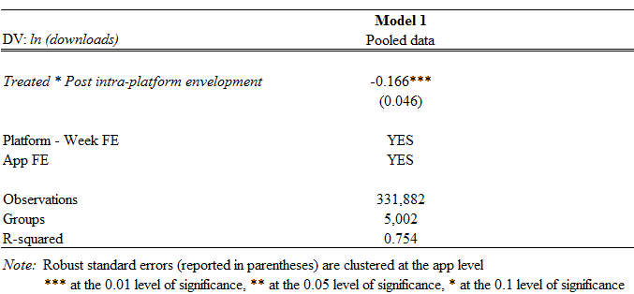
Notes:
Overall, in the pooled sample of both Apple and Google app stores, I find the negative impact of intra-platform envelopment, which is consistent with my hypothesis, arguing competitive, here it means negative, impact of the platform owner’s entry into its own complementors market space

Slide 76


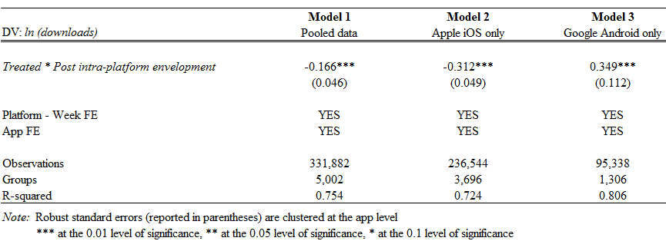

Notes:
Thus, I run separate models by app store, in order to take account into such different platform governance.
My result shows that platform governance indeed matters when exploring competitive dynamics within the platform setting.
Also, this signals the substiles of intra-platform envelopment; which is not always purely positive or negative; its effect varies by and is highly contingent upon platform-specific characteristics.
The coexistence of cooperation and competition

Slide 77
FURTHER HETEROGENEOUS EFFECTS
App-specific characteristics
App price
In-app purchase
Developer-specific characteristics
Prior industry experience

Slide 78
CONTRIBUTION TO:
Platform literature
Entrepreneurship literature
Coopetition literature

Slide 79
The effect of “intra”-platform envelopment is significant
There exists coopetitive dynamics “within”-the platform
Platform governance matters

Slide 80
The effect of “intra”-platform envelopment is significant
There exists coopetitive dynamics “within”-the platform
Platform governance matters

Slide 81




One-to-Many Matching Auctions in Platforms
Platforms
Buyer
Merchant
Hemant K. Bhargava, Gergely CsapÓ, Rudolf MÜller

Slide 82



Matching in Platforms
Passive Matching
Active Matching
Buyer
Merchants
Buyer
Merchant

Slide 83
Monetizing One-to-One Matching
Buyers
Merchants

Slide 84
One-to-One Matching via Auctions
$
$
$
$
$
$
$
$
$
$
Buyers
Merchants

Slide 85
Practicing One-to-Many Matching
Buyers
Merchants

Slide 86




One-to-Many Matching
Insurance
Car Sales

Slide 87
Re-Matching in One-to-One Matching
Buyers
Merchants

Slide 88

Merchants’ Perspective on
Exclusive vs. Shared Matching
VS.

Slide 89
What Kind of Matching?
Shared Matching
Exclusive Matching
$10
$11
$25
$14

Slide 90
What Kind of Matching?
Shared Matching
Exclusive Matching
$10
$11
$36
$14

Slide 91
Value of Shared vs Exclusive Matching
 |  | Scenario 1 |  |  |  |  |  | Scenario 2
Valuation |  | D1 | D2 | D3 | D4 | D5 |  | D1 | D2 | D3 | D4 | D5
Shared Purchase (s_{i}) |  | 10 | 11 | 14 | 8 | 9 |  | 10 | 11 | 14 | 8 | 9
Exclusive Purchase |  | 25 | 15 | 20 | 20 | 9 |  | 36 | 15 | 20 | 20 | 9
Exclusivity Margin (m_{i}) |  | 15 | 4 | 6 | 12 | 0 |  | 26 | 4 | 6 | 12 | 0

Slide 92
Bid Shading
 |  | Scenario 1 |  |  |  |  |  | Scenario 2
Valuation |  | D1 | D2 | D3 | D4 | D5 |  | D1 | D2 | D3 | D4 | D5
Shared Purchase (s_{i}) |  | 10 | 11 | 14 | 8 | 9 |  | 10 | 11 | 14 | 8 | 9
Exclusive Purchase |  | 25 | 15 | 20 | 20 | 9 |  | 36 | 15 | 20 | 20 | 9
Exclusivity Margin (m_{i}) |  | 15 | 4 | 6 | 12 | 0 |  | 26 | 4 | 6 | 12 | 0
Bids
8 6 10 9 7
8 6 10 9 7
20 18 17 11 7
33 18 17 11 7
12 12 7 2 0
25 12 7 2 0
Messy Process
Hurt Adoption
Loss of Trust

Slide 93
Incentive Compatible Auctions
All Auction Formats
Practical
Easy to Implement
What is the best IC auction?
Incentive Compatible Auction

Slide 94
Designing an IC Auction
The Mode of Matching
The Winning Merchants (x_i = 1)
The Price(s) Paid (p^{i}) by the Winning Merchant(s)
Bids |  | D1 | D2 | D3 | D4 | D5
Shared Purchase (s_{i}) |  | 10 | 11 | 14 | 8 | 9
Exclusive Purchase |  | 25 | 15 | 20 | 20 | 9
Merchants Make Shared & Exclusive Bids

Slide 95
Optimal IC Auction
[ ]
E_{t}
∑p^{i}(t)
max
x(t),p(t)
i
(Expected Revenue*)
Subject to
A A A A
ˆ
(Truthful Bidding)
u^{i} ( x (t), p(t), t^{i} ) ≥ u^{i} (x (t^{i}, t^{-i}), t^{i} )
i, t^{- i}, t^{i}, t^{i},
u^{i} ( x (t), p(t), t^{i} ) ≥ 0
A A
(Truthful Bidding)
i, t^{i},

Slide 96
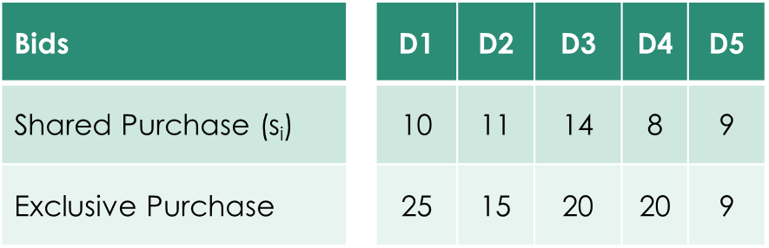
Optimal IC Auction
Bids
Allocations
x1 = 1
x2 = 1
x3 = 1
x4 = 0
x5 = 0
Hard to Solve
Not Implementable

Slide 97
Develop a Pretty Good IC Auction
Upper Bound:
Not feasible
Give ceiling for all real feasible designs
Revenue
Optimal Solution?
Lower Bound:
Heuristic designs that can be specified
Types of Auctions

Slide 98
Develop a Pretty Good IC Auction
RM
A Revenue-Maximizing Heuristic Auction
Specific Set of Pricing and Allocation Rules
Reserve Price for Each Iteration
Determined Based on Prior Distributions for Each Product
Upper Bound:
Not feasible
Give ceiling for all real feasible designs
Revenue
Optimal Solution?
Lower Bound:
Heuristic designs that can be specified
Types of Auctions

Slide 99

Develop a Pretty Good IC Auction
RM Performs Very Well
RM
A Revenue-Maximizing Heuristic Auction
Specific Set of Pricing and Allocation Rules
Reserve Price for Each Iteration
Determined Based on Prior Distributions for Each Product
10-40% Increase
in Platform Profits!
With RM
Profit
Revenue
Not using
One-to-Many Matching
Already using
One-to-Many Matching
Types of Auctions

Slide 100
RM Performs Very Well
Thank You
10-40% Increase
in Platform Profits!
With RM
With RM
5-20% Increase in Platform Profits
Profit
Not using
One-to-Many Matching
Already using
One-to-Many Matching
For more details and the paper, contact hemantb@gmail.com

Slide 101
Value CO-creation and CAPTURE in CREATIVE INDUSTRIES: The U.S. Home Video Game Market
JAGUAR
Carmelo Cennamo
Bocconi University
Joint with Feng Zhu (Harvard U.) and Yuan Gu (Harvard U.)
Platform Strategy Symposium 2017

Slide 102

Value in The Age of Platforms
Apple’s App Store
1.4 million apps in 2014
$5 billion revenue for Apple
$10 billion for app developers
Notes:
Platforms are becoming increasingly important in today’s economy. And thanks to these platforms, today I have so many different ways to waste my time.
Because of the growing importance of platforms, many scholars have done research trying to understand these markets. These studies, including some of my own research, almost exclusively focus on platform owners in these markets – For instance, they try to understand how platform owners can scale up their businesses, how they set optimal prices to different types of participants in their markets, how they compete with their competitors.
But it is important to keep in mind, platform owners are not creating value alone – millions of entrepreneurs, often called complementors, … they are important sources of innovation and value creation. For example. ….
So in one stream of my research, I depart from the usual focus on platform owners and study the success and failure of these complementors. Through my conversations with many complementors in different platform markets,

Slide 103
Value in The Age of Platforms
Complementors are under constant threat of platform’s entry in their segment
Notes:
Platforms are becoming increasingly important in today’s economy. And thanks to these platforms, today I have so many different ways to waste my time.
Because of the growing importance of platforms, many scholars have done research trying to understand these markets. These studies, including some of my own research, almost exclusively focus on platform owners in these markets – For instance, they try to understand how platform owners can scale up their businesses, how they set optimal prices to different types of participants in their markets, how they compete with their competitors.
But it is important to keep in mind, platform owners are not creating value alone – millions of entrepreneurs, often called complementors, … they are important sources of innovation and value creation. For example. ….
So in one stream of my research, I depart from the usual focus on platform owners and study the success and failure of these complementors. Through my conversations with many complementors in different platform markets,

Slide 104
Research Question
How does direct competition from platform owners affect complementors’ ability to capture value in creative industries?

Slide 105


Creative Industries: Relevance for Platform Strategy
Consumers want variety/blockbusters
Content gets obsolete shortly
More opportunities for complementors to capture value

Slide 106
Creative Industries: Relevance for Platform Strategy
Consumers want variety/blockbusters
Content gets obsolete shortly
More opportunities for complementors to capture value

Slide 107
Relevance beyond Platforms

Slide 108
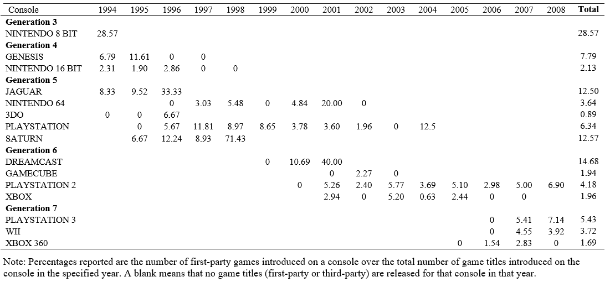
Percentage of first-party games

Slide 114
Swimming with the sharks can be good

Slide 115
Swimming with the sharks can be good

Slide 116
Implications – is free-riding good overall?

Slide 117
Implications – is free-riding good overall?

Slide 118
Thank you!
carmelo.cennamo@unibocconi.it
fzhu@hbs.edu

Slide 119
Thank you!
carmelo.cennamo@unibocconi.it
fzhu@hbs.edu

Slide 120
Thank you!
carmelo.cennamo@unibocconi.it
fzhu@hbs.edu

Slide 121

Strategic Surge Pricing &
Forecast Communication in On-Demand Service Platforms
Harish Guda
Joint Work with Upender Subramanian
The University of Texas at Dallas

Slide 122


Request
On-Demand Platform
Available
Match
Serve

Slide 123

For on-demand service, workers need to be available at the right times and locations.

Slide 124

“GIG” ECONOMY
“Drivers are independent agents. They are our customers as much as riders are. We cannot tell them where to move. We suggest where we think they might want to move.”
– Robert Philips, Marketplace Optimization and Data Science @ Uber

Slide 125

FUNDAMENTAL CHALLENGE
How do you manage on-demand service when you cannot directly control workers?

Slide 126
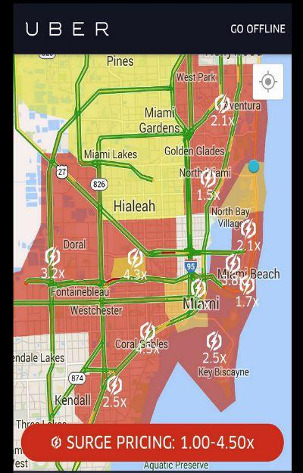
TWO STRATEGIES
Share Forecasts with Workers:
Continually predict and share market need for workers
Surge Pricing:
Temporarily raise price at a location

Slide 127
Uber’s Instruction for Drivers
Your partner app’s map shades certain areas of the city in a color spectrum of yellow, orange and red. These colors indicate areas with higher current demand for rides.
Use this info to your advantage by heading toward surging areas to receive nearby ride requests. Riders who request pickup in shaded areas have agreed to surge pricing for their trip fares.

Slide 128
SURGE PRICING: ECON 101
Workers allocated to customers who value them the most
Surge price attracts more workers (from adjacent zones)

Slide 129
SURGE PRICING
FORCING DRIVERS AWAY !?!
  “When an area is surging, it just kills demand, and a large fraction of the drivers leave the area and drive elsewhere…”
  “[Surge pricing] is not incentivizing drivers the way [Uber] hoped it would”
  Source: Chen, Mislove and Wilson (2015)

Slide 130
DRIVER COMMENTS
“When you arrived [at a surging area], just like the other drivers did, the price went back to normal because all of a sudden, the supply was more than the demand”.
“Are Uber heat maps/demand areas REALLY generated by high passenger demand?”

Slide 131
THIS PAPER
First to model spatial dimension of surge pricing, and forecast communication.
Explicitly account for
Workers’ strategic incentives to move between zones
Platform’s strategic incentives to share forecasts truthfully

Slide 132


MODEL OVERVIEW
Demand in Period 2 is uncertain.
The platform forecasts demand and shares with workers.
Zone A
Zone B
Period 1
Period 2

Slide 133
MODEL OVERVIEW
Workers can move between zones.
Moving between zones is costly and requires one period.
Zone A
Zone B
Period 1
Period 2

Slide 134


WILL SHARING FORECASTS ALONE
MAKE ENOUGH WORKERS MOVE?
Not always.
in Zone B: +ve opportunity cost of moving to Zone A.
Zone A
Zone B
Period 1
Period 2

Slide 135
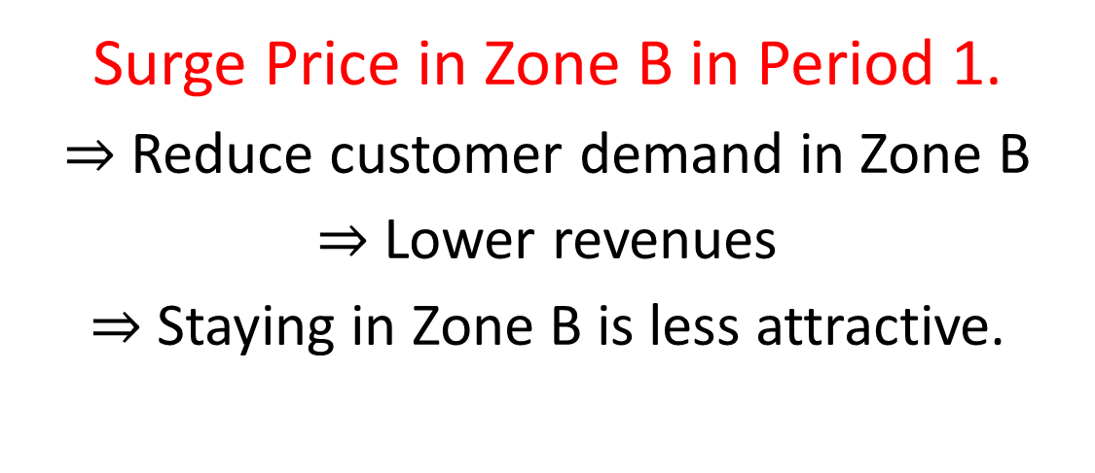
WHAT CAN PLATFORM DO?
Surge Price in Zone B in Period 1.
$⇒$Reduce customer demand in Zone B
$⇒$ Lower revenues
$⇒$ Staying in Zone B is less attractive.

Slide 136
STRATEGIC SURGE PRICING
Result: Strategic surge pricing is profitable if demand surge is high and drivers cost to move is neither too low nor too high.
Rationalizes findings of Chen,Mislove & Wilson (2015) that surge pricing forces drivers to leave.

Slide 137
STRATEGIC VS. CONVENTIONAL
SURGE PRICING
Surge price ahead of actual demand spike
In the zone where there is no demand spike
Forces workers to leave zone with surge price
Reduces platform profit in that zone but maximizes profit across zones

Slide 138
WHAT ABOUT
PAYING WORKERS TO MOVE?
Result: Have to pay ALL workers that move (not just additional workers)
Not profitable if rev sharing rate is high
Strategic surge pricing is still optimal

Slide 139
WILL PLATFORM
SHARE FORECASTS TRUTHFULLY?
Not always.
May benefit from exaggerating need to move.
Result: Platform may use strategic surge pricing to make communication truthful.

Slide 140
MANAGERIAL IMPLICATIONS
Simply informing workers is not sufficient to ensure that they will be available where needed.
Scope of surge pricing is more than what ECON 101 tells us.
Paper available on SSRN. Updated version coming soon!

Slide 141
Winning by Learning?
An Exploratory Study of Knowledge Sharing and Usage on Crowdsourcing Platforms
Yuan Jin, Sulin Ba, Brian Lee, Jan Stallaert
Department of Operations and Information Management School of Business
University of Connecticut

Slide 142






Crowdsourcing
Crowdsourcing: the act of a company or institution taking a function once performed by employees and outsourcing it to a network of people in the form of an open call (Howe and Robinson 2006)
Crowdsourcing platforms

Slide 143



Crowdsourcing Contests
Seekers
seek solutions
choose winners
Contestants
provide solutions
Contests
held by the crowdsourcing platform

Slide 144
Crowdsourcing Contests
Seekers
seek solutions
choose winners
Contestants
provide solutions
Contests
held by the crowdsourcing platform

Slide 145


Success Factors of Crowdsourcing
Crowdsourcing contests provide an unprecedented scale of workforce for firms to generate new ideas and innovative solutions.
Parallel path effect: the likelihood of getting a desirable solution will increase when there are more submissions (Boudreau et al. 2011, Terwiesch and Xu 2008).
Stimulating effect: the high ability contestants are more likely to put more effort in creating new solutions when facing more competitors (Boudreau et al. 2016, List et al. 2014).
Notes:
Particularly, some researchers have suggested that the quality of the winning solution can be represented as a function of the size of the crowds because of the two important effects.
The first effect is the parallel path effect. It suggests that the likelihood of getting a desirable solution will increase when there are more contestants. The rationale behind this effect is straight forward. It is because when there are more contestants, it is more likely to have a good contestant. Therefore, it is more likely to have high quality winning solutions from the crowd with good contestants.
The second effect is the competition effect. It suggests that the high ability contestants are more likely to put effort when they face more competitors. It is because if they fail to put more effort to the contest when they face more competitors, their chance of winning will be reduced.

Slide 146
Success Factors of Crowdsourcing
Crowdsourcing contests provide an unprecedented scale of workforce for firms to generate new ideas and innovative solutions.
Parallel path effect: the likelihood of getting a desirable solution will increase when there are more submissions (Boudreau et al. 2011, Terwiesch and Xu 2008).
Stimulating effect: the high ability contestants are more likely to put more effort in creating new solutions when facing more competitors (Boudreau et al. 2016, List et al. 2014).
Notes:
Particularly, some researchers have suggested that the quality of the winning solution can be represented as a function of the size of the crowds because of the two important effects.
The first effect is the parallel path effect. It suggests that the likelihood of getting a desirable solution will increase when there are more contestants. The rationale behind this effect is straight forward. It is because when there are more contestants, it is more likely to have a good contestant. Therefore, it is more likely to have high quality winning solutions from the crowd with good contestants.
The second effect is the competition effect. It suggests that the high ability contestants are more likely to put effort when they face more competitors. It is because if they fail to put more effort to the contest when they face more competitors, their chance of winning will be reduced.

Slide 147
Success Factors of Crowdsourcing
Crowdsourcing contests provide an unprecedented scale of workforce for firms to generate new ideas and innovative solutions.
Parallel path effect: the likelihood of getting a desirable solution will increase when there are more submissions (Boudreau et al. 2011, Terwiesch and Xu 2008).
Stimulating effect: the high ability contestants are more likely to put more effort in creating new solutions when facing more competitors (Boudreau et al. 2016, List et al. 2014).
Notes:
Particularly, some researchers have suggested that the quality of the winning solution can be represented as a function of the size of the crowds because of the two important effects.
The first effect is the parallel path effect. It suggests that the likelihood of getting a desirable solution will increase when there are more contestants. The rationale behind this effect is straight forward. It is because when there are more contestants, it is more likely to have a good contestant. Therefore, it is more likely to have high quality winning solutions from the crowd with good contestants.
The second effect is the competition effect. It suggests that the high ability contestants are more likely to put effort when they face more competitors. It is because if they fail to put more effort to the contest when they face more competitors, their chance of winning will be reduced.

Slide 148
Knowledge Sharing on Crowdsourcing Platforms
Knowledge sharing: the provision of information to others, can occur in many ways on crowdsourcing platforms
  Positive Effects
    Facilitate information exchange
    Provide knowledge resources
    Lower costs, facilitate product development, improve performance, etc.
  Negative Effects
    Interrupt independent solution searching process
    Limit contestants’ creativity
Notes:
Examples of knowledge sharing on crowdsourcing platform to clarify
Positive effect (general)
Negative effect (particularly for crowdsourcing)
Positive and negative effects -> questions

Slide 149
Knowledge Sharing on Crowdsourcing Platforms
Knowledge sharing: the provision of information to others, can occur in many ways on crowdsourcing platforms
  Positive Effects
    Facilitate information exchange
    Provide knowledge resources
    Lower costs, facilitate product development, improve performance, etc.
  Negative Effects
    Interrupt independent solution searching process
    Limit contestants’ creativity
Notes:
Examples of knowledge sharing on crowdsourcing platform to clarify
Positive effect (general)
Negative effect (particularly for crowdsourcing)
Positive and negative effects -> questions

Slide 150
Research Questions
Does knowledge sharing have an impact on crowdsourcing contests?
How do different dimensions (originality & quality) of knowledge sharing affect contest outcomes and contestant performance?
Knowledge Sharing
Parallel Path Effect
Crowdsourcing Outcome
Stimulating Effect
Taking contestant heterogeneity into account, would knowledge sharing have differential effect on contestants?
Notes:
First show a diagram on slide
Then questions

Slide 151
Research Questions
Does knowledge sharing have an impact on crowdsourcing contests?
How do different dimensions (originality & quality) of knowledge sharing affect contest outcomes and contestant performance?
Knowledge Sharing
Parallel Path Effect
Crowdsourcing Outcome
Stimulating Effect
Taking contestant heterogeneity into account, would knowledge sharing have differential effect on contestants?
Notes:
First show a diagram on slide
Then questions

Slide 152
Research Questions
Does knowledge sharing have an impact on crowdsourcing contests?
How do different dimensions (originality & quality) of knowledge sharing affect contest outcomes and contestant performance?
Knowledge Sharing
Parallel Path Effect
Crowdsourcing Outcome
Stimulating Effect
Taking contestant heterogeneity into account, would knowledge sharing have differential effect on contestants?
Notes:
First show a diagram on slide
Then questions

Slide 153
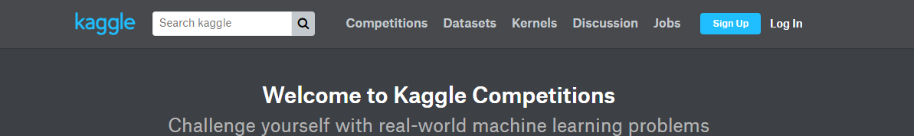

Research Context: Kaggle.com
On Kaggle, people can share coding scripts associated with a contest.

Slide 154

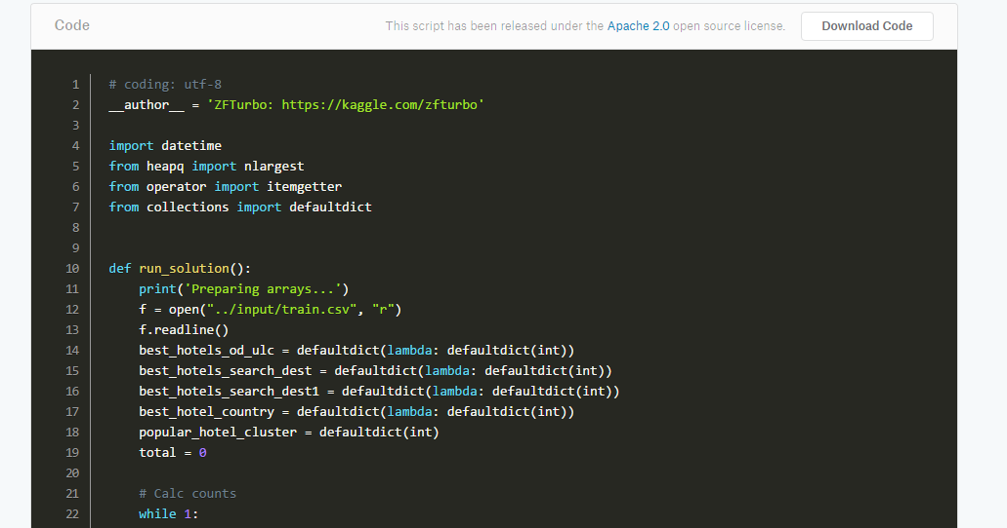
Knowledge Sharing on Kaggle: Script Sharing

Slide 155
Findings
Does knowledge sharing have an impact on crowdsourcing contests?
Difference-in-Differences Analysis:
Knowledge sharing does have a causal effect on crowdsourcing contest outcomes.
How do different dimensions (originality & quality) of knowledge sharing affect contest outcomes?
Contest-level Analysis:
High originality decreases the parallel path effect & stimulating effect negatively affects contest outcomes
High quality amplifies the stimulating effect positively affects contest outcomes

Slide 156
Findings
Does knowledge sharing have an impact on crowdsourcing contests?
Difference-in-Differences Analysis:
Knowledge sharing does have a causal effect on crowdsourcing contest outcomes.
How do different dimensions (originality & quality) of knowledge sharing affect contest outcomes?
Contest-level Analysis:
High originality decreases the parallel path effect & stimulating effect negatively affects contest outcomes
High quality amplifies the stimulating effect positively affects contest outcomes

Slide 157
Findings
Does knowledge sharing have an impact on crowdsourcing contests?
Difference-in-Differences Analysis:
Knowledge sharing does have a causal effect on crowdsourcing contest outcomes.
How do different dimensions (originality & quality) of knowledge sharing affect contest outcomes?
Contest-level Analysis:
High originality decreases the parallel path effect & stimulating effect negatively affects contest outcomes
High quality amplifies the stimulating effect positively affects contest outcomes

Slide 158
Findings
How do different dimensions (originality & quality) of knowledge sharing affect contestant performance?
Taking contestant heterogeneity into account, would knowledge sharing have differential effect on contestants?
Contestant-level Analysis:
Overall, high originality negatively affects contestant performance and high quality positively affects contestant performance.
Contestant Heterogeneity Analysis (Finite Mixture Model):
Contestants vary in their ways of using the shared knowledge and hence are influenced by knowledge sharing differently.

Slide 159
Findings
How do different dimensions (originality & quality) of knowledge sharing affect contestant performance?
Taking contestant heterogeneity into account, would knowledge sharing have differential effect on contestants?
Contestant-level Analysis:
Overall, high originality negatively affects contestant performance and high quality positively affects contestant performance.
Contestant Heterogeneity Analysis (Finite Mixture Model):
Contestants vary in their ways of using the shared knowledge and hence are influenced by knowledge sharing differently.

Slide 160
Findings
How do different dimensions (originality & quality) of knowledge sharing affect contestant performance?
Taking contestant heterogeneity into account, would knowledge sharing have differential effect on contestants?
Contestant-level Analysis:
Overall, high originality negatively affects contestant performance and high quality positively affects contestant performance.
Contestant Heterogeneity Analysis (Finite Mixture Model):
Contestants vary in their ways of using the shared knowledge and hence are influenced by knowledge sharing differently.

Slide 161
From Proprietary to Collective Governance:
How Platform Participant Strategies Adapt
Siobhan O’Mahony & Becky Karp
July 13, 2017

Slide 162

Motivation: Many scholars study trades-offs between proprietary and open platforms
Proprietary
Open
No or limited access and use of intellectual property
Ability to access, modify use or recombine intellectual property
Notes:
Platform: a set of common components or frameworks that mediate producers of goods on one side and users of goods on the other (Bresnahan and Greenstein, 1999; Rochet and Tirole, 2003; Parker and Van Alstyne, 2005; Boudreau, 2010; Boudreau and Jeppesen, 2015)

Slide 163
Motivation: But how do platforms transition?
Proprietary
Open
Notes:
Points of control are constantly evolving (e.g. Mozilla, Sun, Symbian, Android)
Leadership of a platform can be contested, the rules can be changed to affect an entire ecosystems (Adner, 2016)
Affecting the pay off structure for all firms participating in it (e.g. Gavetti and Helfat, 2016)
Little research examines platform transitions nor how such transitions affects participating firms (Chesbrough and Appleyard forthcoming)
Understanding platform transitions, may be key to explaining ecosystem dynamics

Slide 164

Motivation: Governance consists of both access and control
Proprietary
Open ?
Open Access
But who has the keys?
Who has control?
How do platforms transition?
Notes:
A proprietary platform can open, but who retains or is granted control? How is it governed? These decisions may have implications for the firms engaging with the platform

Slide 165

Research Question
How do participants adapt their strategies when a platform transitions from proprietary to collective control?
?
?
?
?
?
?
?
?
?
?
?
?
Notes:
Can I modify the platform
Will I retain ownership of any IP I create by recombining the platform
Can I decide who else can access the platform?
What is the future direction of the platform?

Slide 166









Research Setting
Notes:
An integrated development environment (IDE) platform originally created by IBM to fill a technical void in the market that experienced several control transitions
A unique open source community designed for commercial purposes with a corporate consortia overlay (230 firms in 2016)
May 2014, approximately 48% of all developers utilize Eclipse’s IDE
May 2016, millions and millions of commits
Approximately 4,000+ distinct code developers
50,000 contributors (includes bug fixes)
All phases of transition available for study over time enable longitudinal lens (public project)
Public forums, working groups, board archives, etc.
Selecting on a successful case for strategic reasons
Most platform control transitions have failed (e.g. Symbian, Java, Mozilla)
Extensible general purpose technology
Attractive to both individual developers and most software firms

Slide 167
Field data collected
Dates | 2000 | 2001-2003 | 2004-2005 | 2006-2016+
(1) Interviews (44)
(2) Observations (90+ hrs.)
(3) Archival Data
Board meetings
Sponsor documents
Foundation financial reports
Blogs and press releases
Analyst reports

Slide 168


5 Staged Analytic Approach
Proprietary
Sponsored
Hybrid
Collective
1) Defined 4 Platform Control Phases
2) Identified 10
Strategic Choices
Use Eclipse
Join
Eclipse
Join
Board
Donate Code
Join Multiple Projects
Sync Development Schedule
Commercialize Around Eclipse
Join Project
Develop Committers
Lead a Project
3) Analyzed Participation Intensity
4) Analyzed Platform Alignment
5) Identified Platform Strategies
=
OR
+

Slide 169
5 Staged Analytic Approach
Proprietary
Sponsored
Hybrid
Collective
1) Defined 4 Platform Control Phases
2) Identified 10
Strategic Choices
Use Eclipse
Join
Eclipse
Join
Board
Donate Code
Join Multiple Projects
Sync Development Schedule
Commercialize Around Eclipse
Join Project
Develop Committers
Lead a Project
3) Analyzed Participation Intensity
4) Analyzed Platform Alignment
5) Identified Platform Strategies
=
OR
+

Slide 170
Governance Domains
Membership | Who assigns voting rights? | IBM
 | Who has voting rights? | IBM
Legal | Who owns code donated to or developed as part of Eclipse? | IBM
 | Who can check providence, assert licenses? | IBM
 | Who acquires rights to derivate work that leverages Eclipse code? | IBM
Architectural | Who determines the architectural direction and scope of Eclipse? | IBM
 | How are architectural decisions prioritized and coordinated across projects? | IBM
 | How are new projects are launched? | IBM
Technical | How are project requirements captured and prioritized? | IBM
 | Who determines when projects are released? | IBM
 | Who can commit code to an Eclipse project? | IBM
IBM
Board
Participants
Participants
Participants
IBM
IBM
IBM
IBM
IBM
IBM
Board
Board
Participants
Board
Participants
?
?
?
Project Leaders
Project Leaders
Project Leaders
Board
Board
Participants
Board
Participants
Board
Board
Board
Project Leaders
Project Leaders
Project Leaders
Control
Access
Notes:
Proprietary Control (2000-2001): Proprietary control is defined as complete legal ownership, technical control and decision rights over all platform domains.
Sponsor Control (2001-2003): Sponsor control is defined as legal ownership and technical control of a platform by a sponsor under an “open source” license, providing others select decision rights, open access to source code and the ability to appropriate rents from derivative or complementary products.
Hybrid Control (2004-2005): Hybrid control occurs when a platform sponsor transitions legal stewardship to an independent entity, without ceding all decision rights, technical control and architectural direction.
Community Control (2006+): Community control occurs when an independent steward manages legal rights to the platform; a community’s members manage the technical direction and decisions rights are allocated through a representative governance structure.

Slide 171
Governance Domains
Membership | Who assigns voting rights? | IBM
 | Who has voting rights? | IBM
Legal | Who owns code donated to or developed as part of Eclipse? | IBM
 | Who can check providence, assert licenses? | IBM
 | Who acquires rights to derivate work that leverages Eclipse code? | IBM
Architectural | Who determines the architectural direction and scope of Eclipse? | IBM
 | How are architectural decisions prioritized and coordinated across projects? | IBM
 | How are new projects are launched? | IBM
Technical | How are project requirements captured and prioritized? | IBM
 | Who determines when projects are released? | IBM
 | Who can commit code to an Eclipse project? | IBM
IBM
Board
Participants
Participants
Participants
IBM
IBM
IBM
IBM
IBM
IBM
Board
Board
Participants
Board
Participants
?
?
?
Project Leaders
Project Leaders
Project Leaders
Board
Board
Participants
Board
Participants
Board
Board
Board
Project Leaders
Project Leaders
Project Leaders
Control
Access
Notes:
Proprietary Control (2000-2001): Proprietary control is defined as complete legal ownership, technical control and decision rights over all platform domains.
Sponsor Control (2001-2003): Sponsor control is defined as legal ownership and technical control of a platform by a sponsor under an “open source” license, providing others select decision rights, open access to source code and the ability to appropriate rents from derivative or complementary products.
Hybrid Control (2004-2005): Hybrid control occurs when a platform sponsor transitions legal stewardship to an independent entity, without ceding all decision rights, technical control and architectural direction.
Community Control (2006+): Community control occurs when an independent steward manages legal rights to the platform; a community’s members manage the technical direction and decisions rights are allocated through a representative governance structure.

Slide 172
Strategic Choices
Participation Intensity (Degree of Effort)
Low Intensity
High Intensity
Use Eclipse
Join
Eclipse
Join
Board
Donate Code
Join Multiple Projects
Sync Development Schedule
Commercialize Around Eclipse
Join Project
Develop Committers
Lead a Project
1
2
3
4
5
6
Notes:
Contribution – strategic choice to engage at any level with the Eclipse platform (joining is contributing); not just contributing code
Competition – strategic choice that can potentially conflict with the growth, evolution, and quality of the Eclipse platform
Drawing on adner, 2017

Slide 173
1st Phase: Proprietary Platform
Firm 8 “You couldn’t really get inside. We had access to the source code through our contract. With our access, we could take our [commercial, proprietary] functionality and integrate it in so deeply that it just added itself into the menus. We added this value because we integrated so deeply.”
Participation Intensity
contribution
Cooperative
Opportunistic
Platform Alignment
Notes:
Black is competitor
Grey is complementor

Slide 174
2nd Phase: Sponsored Platform
Firm 4: “Well, the entire contribution was from IBM. All of the committers were IBM. All of the requirements were IBM. All of the management was IBM. So, there was both the perception and reality that it was an IBM Trojan horse.”
Contributing
Participation Intensity
contribution
Participating
Cooperative
Opportunistic
Platform Alignment

Slide 175
3rd Phase: Hybrid Platform
Firm 5: “We had a lot of trouble coming up with how are we going to coordinate across ourselves.”
Participation Intensity
contribution
Cooperative
Opportunistic
Platform Alignment

Slide 176
4th Phase: Collective Platform
Firm 6: “There were two things, one was just how much IBM people ran Eclipse and the other was the governance model. Who got to decide on what? So, when they moved to this model where IBM is like any other member company. I think that was one key point.”
Participation Intensity
contribution
Cooperative
Opportunistic
Platform Alignment

Slide 177




Platform Participation Adapts
Proprietary
Sponsor
Hybrid
Collective
Notes:
Platform alignment remained constant for all firms across all phases
Most firms (12/16) adapted participation intensity as the platform transitioned
All firms (15/16) reduced / limited contributions in the hybrid phase even though access and governance was open
After community control was established, (9/16) contributed significant resources with 50% leading projects

Slide 178

Platform Alignment is Stable
Proprietary
Sponsor
Hybrid
Collective
Notes:
Platform alignment remained constant for all firms across all phases
Most firms (12/16) adapted participation intensity as the platform transitioned
All firms (15/16) reduced / limited contributions in the hybrid phase even though access and governance was open
After community control was established, (9/16) contributed significant resources with 50% leading projects

Slide 179
Literature
Tends to study (or model) platform participation as binary (Parker and Van Alstyne, 2017; Boudreau 2010)
Tends to focus on strategy changes of platform leaders (Gawer and Cusumano, 2002)
Has not studied transitions despite the fact that many fail
Findings
We identify a continuous range of participation engagement
We find platform participants to be highly adaptive, changing their strategies with platform transitions
Transitions have a cost – contributions were most depressed during the Hybrid stage when the platform lacked a clear governance model
The study of transitions can shed light on ecosystem dynamics (e.g. Adner & Kapoor, 2010; Iansiti & Levien, 2004)

Slide 180
Literature
Tends to focus on platforms that are either “closed” or “open” (West, 2003)
Tends to focus on challenges with the appropriation of platform content (e.g., Ostrom, 1990; Simcoe, 2013)
Findings
We find that access and control can be managed independently with consequences for participation
We identify specific domains of control which create a range of platform conditions and study 4 different conditions rather than 1
We illuminate the unique challenges associated with the provisioning of common resources rather than with their usage

Slide 181
When Do Information Signals Convey Quality in Digital Platforms?
Sunil Mithas, U. of Maryland
With
Abhishek Kathuria, U. of Hong Kong
Terence Saldanha, Washington State U.
Jiban Khuntia, U. of Colorado Denver
Mariana Andrade, Nanyang Technological U.
Hyeyoung Hah, Florida International U.
Platform Strategy Research Symposium, Boston, 13 July 2017
Notes:
Are Information Signals in Microsourcing Platforms reliable?: An Empirical Analysis
When do information signals convey quality in digital platforms? Inferring vendor quality in digital microsourcing platforms is challenging due to inherent information asymmetry, which can lead to adverse selection or moral hazard. Many platforms address this challenge by incorporating information signals. However, it is difficult for clients to assess whether and when such signals are true reflections of vendor quality. In this study, we test two kinds of information signals, competency signal and goal signal, as indicators of vendor quality. We argue that these two signals are stronger indicators of vendor quality in jobs of longer duration and in jobs involving greater cultural distance between vendor and client. Our empirical analysis uses a leading online microsourcing platform dataset, which contains over 5000 microsourced IT jobs completed by hundreds of vendors and clients located across dozens of countries. We obtain three main findings. First, goal signal is a more reliable indicator than competency signal without accounting for job and vendor characteristics. Second, both signals are stronger indicators of vendor quality in jobs of longer duration. Finally, both signals are stronger indicators of vendor quality in jobs with greater cultural distance between clients and vendors. This paper contributes to the literature on signaling and digital microsourcing platforms by identifying conditions under which information signals are stronger reflections of vendor quality.
This note contains final instructions for your IGNITE presentation at the Platform Strategy Research Symposium next week - Thursday, July 13.
IGNITE sessions are fast paced, fun, and can be riveting for your entire audience. A good example is described here: https://www.lauramfoley.com/ignite/ Another one is here: http://scottberkun.com/2009/how-to-give-a-great-ignite-talk/
1. You have 5 minutes exactly. You will present in order, immediately back-to-back. You must leave the stage when your 5 minutes are up.
2. You have 20 slides exactly, advancing automatically each 15 seconds. You do NOT have control of the clicker.
3. If you want 30, 45, 60 seconds or more for a topic, just duplicate that slide. Two minutes for one image would be 8 versions of the same slide.
4. Any "build" or "animation" should be part of the 15 second slide advance. ALL slides will be reset to advance in 15 seconds regardless of any prior settings.
5. Any slide deck longer than 20 will be cut at 20. Any slide deck shorter than 20 will duplicate the last slide to reach 20.
6. Slides are due to Jessica Orthman (jrco@bu.edu) by end of day July 9. IGNITE slides cannot be accepted late, in order to provide time to assemble all presentations.
7. For the file name, use the format <#>_<last-name>.pptx where <#> is the number of your talk and <last_name> is the family name of the presenter. Your talk number is on the website here http://questromworld.bu.edu/platformstrategy/agenda/
Again, slides CANNOT be accepted late in order to give time to assemble the presentations.
You also have the opportunity to present your material with a poster during cocktails immediately following. This gives a great opportunity to interact with the audience.

Slide 182

We have come a long way
Malone, T. W., Yates, J., and Benjamin, R. I. 1987. "Electronic Markets and Electronic Hierarchies," Communications of the ACM (30:6), pp. 484-497
Notes:
30 years ago
30 years ago: Electronic Markets or Electronic Hierarchies?
Reduced Coordination Costs enabled by digitization: Electronic Markets Replacing Electronic Hierarchies

Slide 183












Digital “Platforms” and “Pipelines”
Van Alstyne, M. W., Parker, G., and Choudary, S. P. 2016. "Pipelines, platforms, and the new rules of strategy," Harvard Business Review (April), pp. 54-62
Pipelines
Platforms
Notes:
Today
Are “Platforms” replacing “Pipelines”? From Firms to Platforms; Firms (VARs)
Parker et al 2016 (1) People understand the razors & blades strategy (same as cellphones & minutes, printers & ink) Give away one thing, charge for another, The SAME person gets both items (2) People often misunderstand 2-sided network pricing: Subsidize one party in order to attract then charge another party, Subsidy side and money side of the market are DIFFERENT parties (like women & men on ladies’ nights) (3) Monetization is trickier for 2-sided networks: Charging the wrong side (or both) reduces growth and network effects
Q: Why is price more important in network markets? A: The entire demand curve can change with price.
Q: Why is price more strategic in 2-sided networks? A: Imagine competing on the subsidy side – you need a source of subsidy at least as great.
Most companies in the world can be classified as pipelines (BP) and platforms (UnitedHealthGroup—it connects patients with providers). Increasingly Pipelines facing competition from High Clock-speed Digital “Platforms” platforms (which are quicker in responding to customer needs) and trying to incorporate platform thinking in their businesses Talk about 1-2 examples: How is Walmart including platform in its business by acquiring Jets.com(?), Unilever acquired DollarShave, Avis acquired Zipcar; how is Amazon going the other way to open brick-and-mortar stores, Trend toward omnichannel strategies, Focused companies becoming like conglomerates (Google, Amazon, Tesla, Apple, Microsoft, Uber– increasingly harder to define them by one particular industry)
Given these dynamics, acquiring software capabilities is important for firms across different industries. There is an imperative to change how IT department functions to respond to need for transformation in business models, in addition to responding to technologies. Together the forces such as increasing clockspeed and changing customer requirements, and need to compete with platform companies are causing a fundamental shift in software development approaches of incumbents.

Slide 184


Digital platforms for microsourcing
“…Freelancer.com and Elance-oDesk links up 9.3m workers for hire with 3.7m companies.”
Notes:
Transforming labor markets for IT work
There is an app for that
Jan 3, 2015 Issue Cover: Freelancer.com and Elance-oDesk, which links up 9.3m workers for hire with 3.7m companies.
https://www.economist.com/news/leaders/21637393-rise-demand-economy-poses-difficult-questions-workers-companies-and
IN THE early 20th century Henry Ford combined moving assembly lines with mass labour to make building cars much cheaper and quicker—thus turning the automobile from a rich man’s toy into transport for the masses. Today a growing group of entrepreneurs is striving to do the same to services, bringing together computer power with freelance workers to supply luxuries that were once reserved for the wealthy. Uber provides chauffeurs. Handy supplies cleaners. SpoonRocket delivers restaurant meals to your door. Instacart keeps your fridge stocked. In San Francisco a young computer programmer can already live like a princess.
Yet this on-demand economy goes much wider than the occasional luxury. Click on Medicast’s app, and a doctor will be knocking on your door within two hours. Want a lawyer or a consultant? Axiom will supply the former, Eden McCallum the latter. Other companies offer prizes to freelances to solve R&D problems or to come up with advertising ideas. And a growing number of agencies are delivering freelances of all sorts, such as Freelancer.com and Elance-oDesk, which links up 9.3m workers for hire with 3.7m companies.
Latest updates
The on-demand economy is small, but it is growing quickly (see article). Uber, founded in San Francisco in 2009, now operates in 53 countries, had sales exceeding $1 billion in 2014 and a valuation of $40 billion. Like the moving assembly line, the idea of connecting people with freelances to solve their problems sounds simple. But, like mass production, it has profound implications for everything from the organisation of work to the nature of the social contract in a capitalist society.
Baby, you can drive my car—and stock my fridge
Some of the forces behind the on-demand economy have been around for decades. Ever since the 1970s the economy that Henry Ford helped create, with big firms and big trade unions, has withered. Manufacturing jobs have been automated out of existence or outsourced abroad, while big companies have abandoned lifetime employment. Some 53m American workers already work as freelances.
But two powerful forces are speeding this up and pushing it into ever more parts of the economy. The first is technology. Cheap computing power means a lone thespian with an Apple Mac can create videos that rival those of Hollywood studios. Complex tasks, such as programming a computer or writing a legal brief, can now be divided into their component parts—and subcontracted to specialists around the world. The on-demand economy allows society to tap into its under-used resources: thus Uber gets people to rent their own cars, and InnoCentive lets them rent their spare brain capacity.
The other great force is changing social habits. Karl Marx said that the world would be divided into people who owned the means of production—the idle rich—and people who worked for them. In fact it is increasingly being divided between people who have money but no time and people who have time but no money. The on-demand economy provides a way for these two groups to trade with each other.
This will push service companies to follow manufacturers and focus on their core competencies. The “transaction cost” of using an outsider to fix something (as opposed to keeping that function within your company) is falling. Rather than controlling fixed resources, on-demand companies are middle-men, arranging connections and overseeing quality. They don’t employ full-time lawyers and accountants with guaranteed pay and benefits. Uber drivers get paid only when they work and are responsible for their own pensions and health care. Risks borne by companies are being pushed back on to individuals—and that has consequences for everybody.

Slide 185

Freelancer.com
Vendors or IT Workers
Clients
Platform

Slide 186
Digital platforms suffer from the problem of information asymmetry
Adverse Selection
Job Complexities
Duration
Cultural distance
Moral Hazard
Pre Contract
Post Contract
Information Signals
Competency signal
Goal signal
Notes:
The problem of information asymmetry
Information asymmetry in Digital Platforms
Global Sourcing expanded in scope and geography
Microsourcing: sourcing of small-sized jobs by individuals or businesses (Gefen and Carmel 2008; Obal 2009). Enabled by IT platforms, e.g., Mechanical Turk, elance.com
Estimated to rise from $10bn to $63bn globally by 2020. (Kirton 2015)
Competency signal: the information signal that emphasizes a vendor’s technical skill and process related knowledge represented by benchmarking assessments of certifications and examinations.
Goal signal: information signal that emphasizes the vendor’s goal seeking activities within resource constraints of time and budget. represented by vendor’s on-time, within-budget, and successful completion of prior jobs.
Job Duration (Structural Challenge)
Vendors are individuals or small businesses; not equipped with sophisticated infrastructure, process standards, or formal employee management practices (Lu et al. 2013).
Platforms offer limited support for collaboration and coordination; more suitable for short duration jobs not requiring interconnected tasks or coordination of multiple skillsets typical of longer engagements (Kaganer et al 2013).
Cultural Distance (Location Challenge); Physical separation of vendor and client, hindering efficiency and effectiveness of coordination and communication (Jarvenpaa and Keating 2011).
Adverse selection: Client’s choice of wrong/low-quality vendor
Moral Hazard: Unfulfilled Promises; Vendor’s experience & expertise gain at Client’s expenses
Adverse selection occurs when there's a lack of symmetric information prior to a deal between a buyer and a seller, whereas moral hazard occurs when there is asymmetric information between two parties and change in behavior of one party after a deal is struck. Moral hazard and adverse selection are two terms used in economics, risk management and insurance to describe situations where one party is at a disadvantage.
Adverse selection describes an undesired result due to the situation where one party of a deal has more accurate and different information than the other party. The party with less information is at a disadvantage to the party with more information. The asymmetry causes a lack of efficiency in the price and quantity of goods and services.
Read more: What is the difference between moral hazard and adverse selection? | Investopedia http://www.investopedia.com/ask/answers/042415/what-difference-between-moral-hazard-and-adverse-selection.asp#ixzz4mEZ0TPjA

Slide 187
Information signals as solution
Adverse Selection
Job Complexities
Duration
Cultural distance
Moral Hazard
Pre Contract
Post Contract
Information Signals
Competency signal
Goal signal
Notes:
Information asymmetry in Digital Platforms
Global Sourcing expanded in scope and geography
Microsourcing: sourcing of small-sized jobs by individuals or businesses (Gefen and Carmel 2008; Obal 2009).
Enabled by IT platforms, e.g., Mechanical Turk, elance.com
Estimated to rise from $10bn to $63bn globally by 2020. (Kirton 2015)
Competency signal: the information signal that emphasizes a vendor’s technical skill and process related knowledge
represented by benchmarking assessments of certifications and examinations.
Goal signal: information signal that emphasizes the vendor’s goal seeking activities within resource constraints of time and budget.
represented by vendor’s on-time, within-budget, and successful completion of prior jobs.
Job Duration (Structural Challenge)
Vendors are individuals or small businesses
not equipped with sophisticated infrastructure, process standards, or formal employee management practices (Lu et al. 2013).
Platforms offer limited support for collaboration and coordination
more suitable for short duration jobs not requiring interconnected tasks or coordination of multiple skillsets typical of longer engagements (Kaganer et al 2013).
Cultural Distance (Location Challenge)
Physical separation of vendor and client, hindering efficiency and effectiveness of coordination and communication (Jarvenpaa and Keating 2011).
Adverse selection: Client’s choice of wrong/low-quality vendor
Moral Hazard: Unfulfilled Promises; Vendor’s experience & expertise gain at Client’s expenses
Adverse selection occurs when there's a lack of symmetric information prior to a deal between a buyer and a seller, whereas moral hazard occurs when there is asymmetric information between two parties and change in behavior of one party after a deal is struck. Moral hazard and adverse selection are two terms used in economics, risk management and insurance to describe situations where one party is at a disadvantage.
Adverse selection describes an undesired result due to the situation where one party of a deal has more accurate and different information than the other party. The party with less information is at a disadvantage to the party with more information. The asymmetry causes a lack of efficiency in the price and quantity of goods and services.
Read more: What is the difference between moral hazard and adverse selection? | Investopedia http://www.investopedia.com/ask/answers/042415/what-difference-between-moral-hazard-and-adverse-selection.asp#ixzz4mEZ0TPjA
Follow us: Investopedia on Facebook

Slide 188
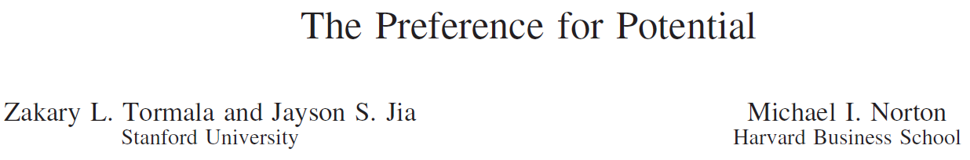
What do we know about information signals?
“…In academic settings, new faculty members often receive disproportionately high salaries given their sparse publication records. ..Accordingly, we propose …the potential for X is valued more than X itself.”
Notes:
Prior work
Does potential matter more than achievement?
When do they matter more?
Tormala, Z. L., Jia, J. S., and Norton, M. I. 2012. "The preference for potential," Journal of Personality and Social Psychology (103:4), pp. 567-583
In professional sports, rookies with no playing experience receive
multimillion-dollar contracts and signing bonuses. In academic
settings, new faculty members often receive disproportionately
high salaries given their sparse publication records. In art and
music contexts too, people often express the most enthusiasm for
artists and musicians who are new to the scene and could—but
have not yet—become the next big thing. Accordingly, we propose
that (as yet) untapped potential can be perceived as more
interesting and ultimately better than demonstrated achievement,
creating a phenomenon whereby the potential for X is valued more
than X itself.

Slide 189
Research Questions
Does potential always trump achievement?
  Which signals are more informative of future performance in digital platforms?
How does the predictive power of signals vary depending on job and vendor characteristics?
Notes:
Information asymmetry in Digital Platforms
Global Sourcing expanded in scope and geography
Microsourcing: sourcing of small-sized jobs by individuals or businesses (Gefen and Carmel 2008; Obal 2009).
Enabled by IT platforms, e.g., Mechanical Turk, elance.com
Estimated to rise from $10bn to $63bn globally by 2020. (Kirton 2015)
Competency signal: the information signal that emphasizes a vendor’s technical skill and process related knowledge
represented by benchmarking assessments of certifications and examinations.
Goal signal: information signal that emphasizes the vendor’s goal seeking activities within resource constraints of time and budget.
represented by vendor’s on-time, within-budget, and successful completion of prior jobs.
Job Duration (Structural Challenge)
Vendors are individuals or small businesses
not equipped with sophisticated infrastructure, process standards, or formal employee management practices (Lu et al. 2013).
Platforms offer limited support for collaboration and coordination
more suitable for short duration jobs not requiring interconnected tasks or coordination of multiple skillsets typical of longer engagements (Kaganer et al 2013).
Cultural Distance (Location Challenge)
Physical separation of vendor and client, hindering efficiency and effectiveness of coordination and communication (Jarvenpaa and Keating 2011).
Adverse selection: Client’s choice of wrong/low-quality vendor
Moral Hazard: Unfulfilled Promises; Vendor’s experience & expertise gain at Client’s expenses
Adverse selection occurs when there's a lack of symmetric information prior to a deal between a buyer and a seller, whereas moral hazard occurs when there is asymmetric information between two parties and change in behavior of one party after a deal is struck. Moral hazard and adverse selection are two terms used in economics, risk management and insurance to describe situations where one party is at a disadvantage.
Adverse selection describes an undesired result due to the situation where one party of a deal has more accurate and different information than the other party. The party with less information is at a disadvantage to the party with more information. The asymmetry causes a lack of efficiency in the price and quantity of goods and services.
Read more: What is the difference between moral hazard and adverse selection? | Investopedia http://www.investopedia.com/ask/answers/042415/what-difference-between-moral-hazard-and-adverse-selection.asp#ixzz4mEZ0TPjA
Follow us: Investopedia on Facebook

Slide 190
Research Model
Job Duration
Cultural Distance
Competency Signal
Vendor Quality
Goal Signal
Notes:
Combating Challenges in Microsourcing: Role of Information Signals
Competency signal: the information signal that emphasizes a vendor’s technical skill and process related knowledge
represented by benchmarking assessments of certifications and examinations.
Goal signal: information signal that emphasizes the vendor’s goal seeking activities within resource constraints of time and budget.
represented by vendor’s on-time, within-budget, and successful completion of prior jobs.
Cost signal: the information signal that emphasizes the vendor’s focus on cost reduction and avoidance.
represented by vendor’s actions with respect to its bid pricing behavior
Job Duration (Structural Challenge)
Vendors are individuals or small businesses
not equipped with sophisticated infrastructure, process standards, or formal employee management practices (Lu et al. 2013).
Platforms offer limited support for collaboration and coordination
more suitable for short duration jobs not requiring interconnected tasks or coordination of multiple skillsets typical of longer engagements (Kaganer et al 2013).
Cultural Distance (Location Challenge)
Physical separation of vendor and client, hindering efficiency and effectiveness of coordination and communication (Jarvenpaa and Keating 2011).
Theoretical foundations
One party (agent) credibly conveys some information about itself to another party (principal) (Spence 1973).
Why relevant to Microsourcing?
High information asymmetry.
Digital nature of platforms exacerbates lack of transparency (Felstiner 2011).
Clients may have to rely on platform information signals.
We test:
information signals as indicators of vendor quality
complexities of job duration and cultural distance

Slide 191
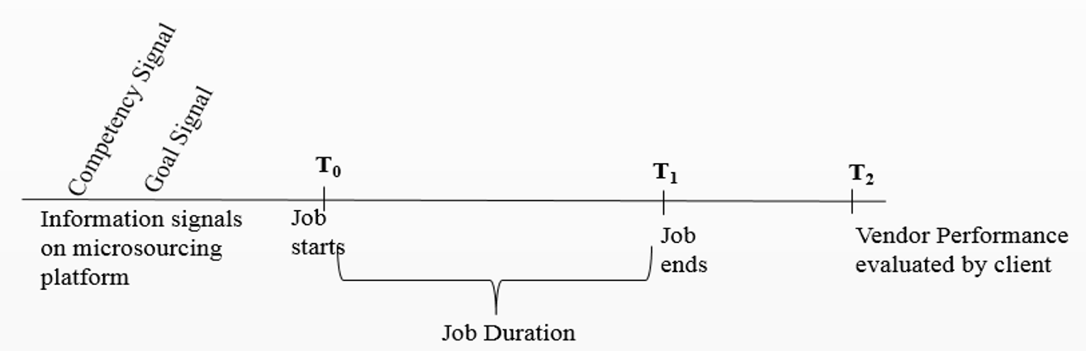
Data
Freelancer.com platform, Jan-Aug 2013
5432 IT jobs in web services, software, mobile app development
Notes:
Data from a leading microsourcing platform.
Sample
5432 IT jobs in web services, software, mobile app development.
3221 clients across 64 countries, completed by 642 vendors from 49 countries
638 distinct client-vendor country tuples.
Empirical model: Double-censored Tobit Model.

Slide 192
Global distribution of vendors and clients
Vendors
Clients
3221 clients across 64 countries
642 vendors from 49 countries
638 distinct client-vendor country dyads
Notes:
Freelancer.com platform, Jan-Aug 2013
Sample: 5432 IT jobs in web services, software, mobile app development.
3221 clients across 64 countries
642 vendors from 49 countries
638 distinct client-vendor country dyads
Data from a leading microsourcing platform.
Sample
5432 IT jobs in web services, software, mobile app development.
3221 clients across 64 countries, completed by 642 vendors from 49 countries
638 distinct client-vendor country tuples.
Empirical model: Double-censored Tobit Model.

Slide 193
Key Variables
Variable | Operationalization
Vendor Quality | The overall evaluation rating after the job’s completion on a continuous scale of 0 to 5,. This variable is log transformed as log (1+ Vendor Quality) to account for skewness.
Competency Signal | Number of IT exams (e.g., PHP programming, iPhone software development) and process-related exams (e.g., vendor orientation, employer orientation) completed by the vendor prior to the focal job. For ease of interpretation, we used the standardized value in the estimations.
Goal Signal | Three-way product of proportion of jobs completed on time, the proportion of jobs completed on-budget, and the proportion of successfully completed jobs in the past. Goal signal = (on-time proportion) x (within-budget proportion) x (completion rate proportion). For ease of interpretation, we used the standardized value in the estimations.
Job Duration | Duration of the focal job, measured in number of days.
Cultural Distance | Cultural distance between the country of location of the vendor and country of location of the client, calculated based on the cultural dimensions identified and used in prior studies.
Notes:
power distance, individualism/collectivism, masculinity/femininity, uncertainty avoidance, long term orientation (Hofstede 1980)
For measuring Cultural Distance, we used the widely used measure similar to Kogut and Singh (1988)’s index (Manev and Stevenson 2001), following adaptations recommended by prior research (Shenkar 2001). This measure is calculated using dimensions of culture based on work of Geert Hofstede, which has emerged as a standard measure of difference in national cultures (Hofstede 1980; Manev and Stevenson 2001; Sousa and Bradley 2008). The index is used in several prior studies (e.g., Griffith, Harmancioglu and Droge 2009; Handley and Benton 2013) and is based on deviation of the vendor’s country from the client’s country along the five Hofstede (1980) cultural dimensions (i.e., power distance, individualism/collectivism, masculinity/femininity, uncertainty avoidance, long-term orientation). These differences are adjusted for differences in variance of each dimension and then arithmetically averaged.
For robustness, we also used an alternate measure of cultural distance and found similar results. This alternate measure is a Euclidean distance index based on Hofstede (1980) (Drogendijk and Slangen 2006; Morosini, Shane and Singh 1998; Yu, Subramaniam and Cannella 2009). Unlike the Kogut and Singh (1988) index, this measure does not assume that differences in scores on each of Hofstede’s dimensions are equally important in determining cultural distance between countries. Instead, in line with the concept of Euclidean distance, it computes their distance in a five dimensional space as the square root of the sum of squared differences in scores on each cultural dimension.
Although the original index proposed by Kogut and Singh (1988) consisted of the first four Hofstede dimensions, we followed prior research which suggests including the fifth dimension as well (Griffith, Harmancioglu and Droge 2009; Shenkar 2001). For further robustness, we repeated the analysis using just the first four dimensions and found similar results. Likewise, we repeated the analysis using the original Kogut and Singh (1988) index without adjusting for variance of each dimension, and found qualitatively unchanged results.

Slide 194
Descriptives and Correlations

Slide 195
Empirical Model and Robustness Tests
Double-censored Tobit Model
Robustness Checks:
1. Accounting for Endogeneity of Signals (Two-step model approach)
2. Alternate Measures of Cultural Distance
3. Clustering of standard errors by vendors and clients
4. Common method bias tests
5. Multicollinearity tests

Slide 196
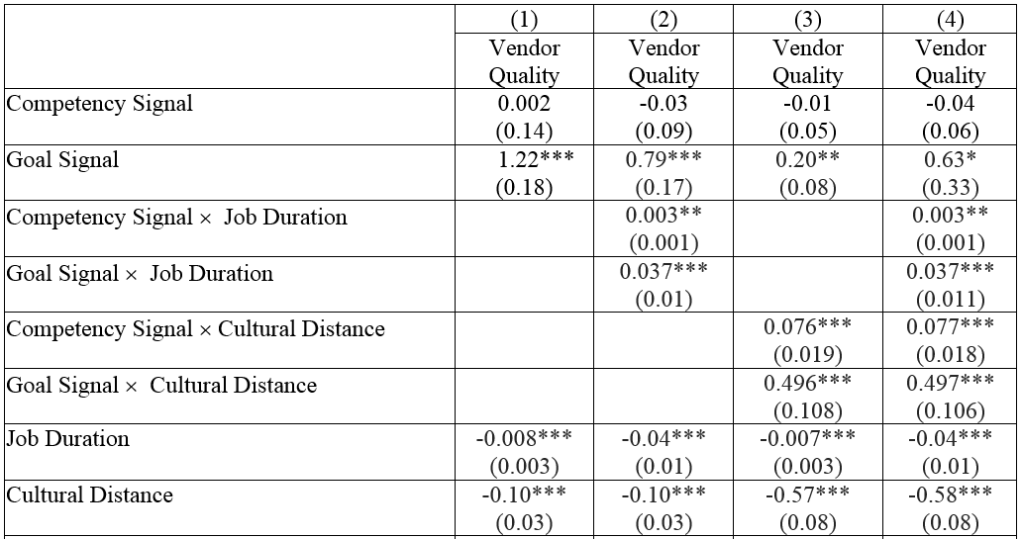
Key Results
Notes:
Data from a leading microsourcing platform freelancer.com.
Sample: 5432 IT jobs in web services, software, mobile app development. 3221 clients across 64 countries, completed by 642 vendors from 49 countries. 638 distinct client-vendor country tuples.
Empirical model: Double-censored Tobit Model.
Sample
5432 IT jobs in web services, software, mobile app development.
3221 clients across 64 countries, completed by 642 vendors from 49 countries
638 distinct client-vendor country tuples.
Empirical model: Double-censored Tobit Model.

Slide 197
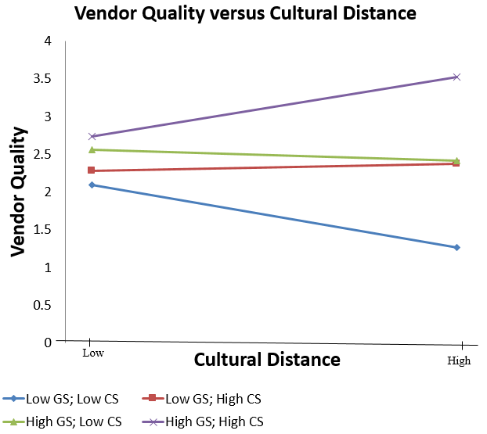
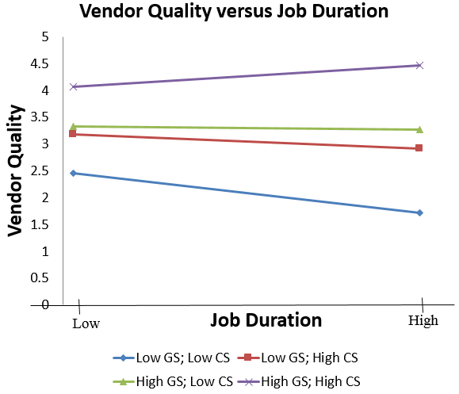
Signals and job complexity
Notes:
Signals become more informative with job complexity
Data from a leading microsourcing platform freelancer.com.
Sample: 5432 IT jobs in web services, software, mobile app development. 3221 clients across 64 countries, completed by 642 vendors from 49 countries. 638 distinct client-vendor country tuples.
Empirical model: Double-censored Tobit Model.
Sample
5432 IT jobs in web services, software, mobile app development.
3221 clients across 64 countries, completed by 642 vendors from 49 countries
638 distinct client-vendor country tuples.
Empirical model: Double-censored Tobit Model.

Slide 198
Summary of Findings
Goal signals (achievement) are more reliable indicators of vendor quality than competency signals (potential) when one does not account for job complexity
Goal and competency signals are more reliable indicators of quality in jobs of longer duration, and higher cultural distance
Goal signals become even more reliable indicators than competency signals in jobs of longer duration, and higher cultural distance
Notes:
Under which conditions can clients trust the reliability of platform information signals?
Both signals are more reliable indicators of quality for vendors who deal with jobs of longer duration.
Microsourcing platforms should institutionalize both signals, particularly when they deal with longer jobs.
For longer jobs, clients should infer vendor quality using both signals rather than relying on one signal only.
Clients dealing with global job sourcing from culturally distant vendors should rely more on goal and competency signals.
Microsourcing motivation may not be solely for cost arbitrage, but competency and goal relying behavior of vendors. Rewarding for such behavior through microsourcing platforms may need to evolve.

Slide 199
Implications for platform design and participants
Platform providers should emphasize greater salience of goal signals (achievement) than competency signals (potential) in general
Clients should choose vendors based on goal signals (achievement) than competency signals (potential), particularly for jobs of longer duration, and involving higher cultural distance
Vendors should assess their capabilities before bidding for jobs of longer duration, and involving higher cultural distance
Notes:
Implications for governance and design of platforms
Information signals and metrics for efficient market design in digital microsourcing platforms
Under which conditions can clients trust the reliability of platform information signals?
Both signals are more reliable indicators of quality for vendors who deal with jobs of longer duration.
Microsourcing platforms should institutionalize both signals, particularly when they deal with longer jobs.
For longer jobs, clients should infer vendor quality using both signals rather than relying on one signal only.
Clients dealing with global job sourcing from culturally distant vendors should rely more on goal and competency signals.
Microsourcing motivation may not be solely for cost arbitrage, but competency and goal relying behavior of vendors. Rewarding for such behavior through microsourcing platforms may need to evolve.

Slide 200
Implications for platform design and participants
Platform providers should emphasize greater salience of goal signals (achievement) than competency signals (potential) in general
Clients should choose vendors based on goal signals (achievement) than competency signals (potential), particularly for jobs of longer duration, and involving higher cultural distance
Vendors should assess their capabilities before bidding for jobs of longer duration, and involving higher cultural distance
Notes:
Implications for governance and design of platforms
Information signals and metrics for efficient market design in digital microsourcing platforms
Under which conditions can clients trust the reliability of platform information signals?
Both signals are more reliable indicators of quality for vendors who deal with jobs of longer duration.
Microsourcing platforms should institutionalize both signals, particularly when they deal with longer jobs.
For longer jobs, clients should infer vendor quality using both signals rather than relying on one signal only.
Clients dealing with global job sourcing from culturally distant vendors should rely more on goal and competency signals.
Microsourcing motivation may not be solely for cost arbitrage, but competency and goal relying behavior of vendors. Rewarding for such behavior through microsourcing platforms may need to evolve.

Slide 201
Market Power and Mergers in Multi-Sided Markets
Mark J. Tremblay
Platform Strategies Research Symposium
July 13, 2017

Slide 202
Market Power and Mergers in Multi-Sided Markets
Mark J. Tremblay
Platform Strategies Research Symposium
July 13, 2017

Slide 203
Market Power and Mergers in Multi-Sided Markets
Mark J. Tremblay
Platform Strategies Research Symposium
July 13, 2017

Slide 204

Platform Market Power
  Traditional Measures:
    Price-cost markups
    Market shares
    Profitability

Slide 205
Platform Market Power
  Traditional Measures:
    Price-cost markups
    Market shares
    Profitability

Slide 206
Platform Market Power
  Traditional Measures:
    Price-cost markups
    Market shares
    Profitability
  What about platforms?
    Price-cost markup of which side? Negative markups?
    Market shares of which side?
    Single side or total profitability?

Slide 207
Platform Market Power
  Traditional Measures:
    Price-cost markups
    Market shares
    Profitability
  What about platforms?
    Price-cost markup of which side? Negative markups?
    Market shares of which side?
    Single side or total profitability?

Slide 208
Platform Market Power
  Traditional Measures:
    Price-cost markups
    Market shares
    Profitability
  What about platforms?
    Price-cost markup of which side? Negative markups?
    Market shares of which side?
    Single side or total profitability?
  I combine markups/market share across sides.

Slide 209

Platform Market Power Measure
  Platform A in a Two-Sided Market:
  $$L^{A}= \frac{\left(p_{1}^{A}−c_{1}^{A}\right)∙s_{1}^{A}+\left(p_{2}^{A}−c_{2}^{A}\right)∙s_{2}^{A}}{\left(p_{1}^{A}\right)∙s_{1}^{A}+\left(p_{2}^{A}\right)∙s_{2}^{A}}$$

Slide 210
Platform Market Power Measure
  Platform A in a Two-Sided Market:
  $$L^{A}= \frac{\left(p_{1}^{A}−c_{1}^{A}\right)∙s_{1}^{A}+\left(p_{2}^{A}−c_{2}^{A}\right)∙s_{2}^{A}}{\left(p_{1}^{A}\right)∙s_{1}^{A}+\left(p_{2}^{A}\right)∙s_{2}^{A}}$$

Slide 211

Platform Market Power Measure
  Platform A in a Two-Sided Market:
  $$L^{A}= \frac{\left(p_{1}^{A}−c_{1}^{A}\right)∙s_{1}^{A}+\left(p_{2}^{A}−c_{2}^{A}\right)∙s_{2}^{A}}{\left(p_{1}^{A}\right)∙s_{1}^{A}+\left(p_{2}^{A}\right)∙s_{2}^{A}}$$
  Also:
  $$L^{A}= \frac{π^{A}}{{TR}^{A}}$$

Slide 212


$5^{th}$ Gen. Video Game Market
  Sony, Nintendo, Microsoft
  Two sides

Slide 213
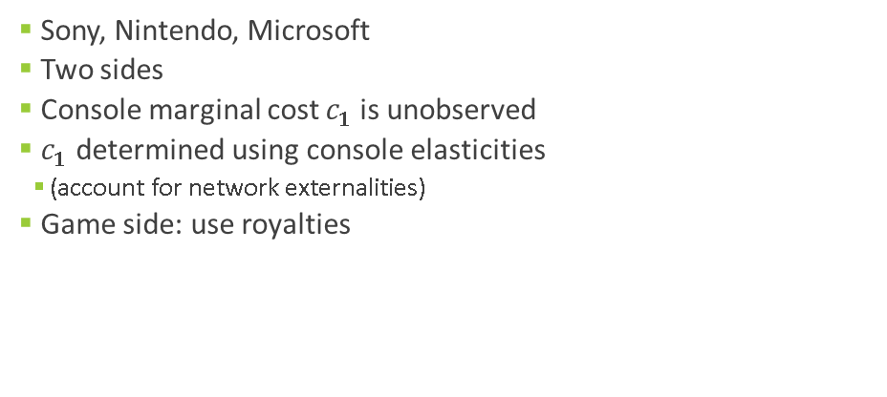
$5^{th}$ Gen. Video Game Market
  Sony, Nintendo, Microsoft
  Two sides
  Console marginal cost $c_{1}$ is unobserved
  $c_{1}$ determined using console elasticities
    (account for network externalities)
  Game side: use royalties

Slide 214
$5^{th}$ Gen. Video Game Market
  Sony, Nintendo, Microsoft
  Two sides
  Console marginal cost $c_{1}$ is unobserved
  $c_{1}$ determined using console elasticities
    (account for network externalities)
  Game side: use royalties

Slide 215


$5^{th}$ Gen. Video Game Market
  Sony, Nintendo, Microsoft
  Two sides
  Console marginal cost $c_{1}$ is unobserved
  $c_{1}$ determined using console elasticities
    (account for network externalities)
  Game side: use royalties
  Market Power Results:

Slide 216
$5^{th}$ Gen. Video Game Market
  Sony, Nintendo, Microsoft
  Two sides
  Console marginal cost $c_{1}$ is unobserved
  $c_{1}$ determined using console elasticities
    (account for network externalities)
  Game side: use royalties
  Market Power Results:

Slide 217
Hypothetical Platform Mergers
  Two platforms merge (e.g., PS2 and Xbox)
  Merged entity pricing:
      Direct diversion – same side to my other platform
      Diversion elsewhere – feedback effect to my other platform

Slide 218
Hypothetical Platform Mergers
  Two platforms merge (e.g., PS2 and Xbox)
  Merged entity pricing:
      Direct diversion – same side to my other platform
      Diversion elsewhere – feedback effect to my other platform

Slide 219
Hypothetical Platform Mergers
  Two platforms merge (e.g., PS2 and Xbox)
  Merged entity pricing:
      Direct diversion – same side to my other platform
      Diversion elsewhere – feedback effect to my other platform
  Merger Sim. Results:
      Console prices increase (up to 4.5%)
      Console sales decrease by merged entity (up to 2.9%)
      Market power increases by each platform

Slide 220
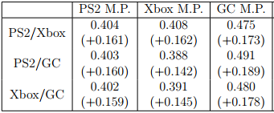
Post-Merger Platform Market Power

