Slide 1
Questrom ITS Accessibility
Optimizing Questrom for Accessible Education

Slide 2
Introductory Note
Accessibility guidelines help ensure that students with disabilities have equal access to course materials, which is an important aspect of inclusive education.
Adherence to accessibility standards can make a significant difference in the ability of students with disabilities to participate fully in their classes and understand course content.
By providing materials in a format compatible with assistive technology and following best practices for design and delivery, instructors can help remove barriers that might otherwise prevent students with disabilities from fully engaging with course content.
This not only benefits individual students, but also creates a more inclusive learning environment for all students, which can enhance the overall learning experience for everyone in the class.

Slide 3
Best Practices When Creating Class Material
Use the Microsoft Office suite
Use the Questrom ITS accessibility optimized template
Follow the accessibility checklist
Use Microsoft Accessibility Checker before sharing
If sharing as PDFs, use the Adobe Action Wizard tool before sharing

Slide 4
Accessibility Checklist
All visuals have alt text
Content on slides can be read in the order you intend
Color is not the only means to convey any information
Text and background color have enough contrast
Every slide has a unique title
Videos have subtitles/ closed captions
Used Microsoft Accessibility Checker
Used Adobe Action Wizard Tool for PDFs

Slide 5
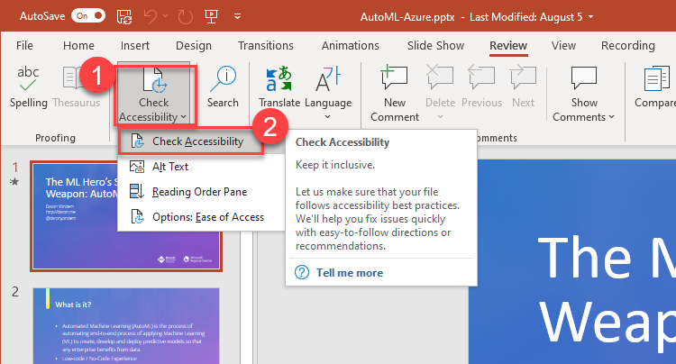
Using the Microsoft Accessibility Checker
In any Microsoft Application:
Go to the Review tab
Click Check Accessibility
Follow the directions provided
For further guidance:
Click here for MS Powerpoint
Click here for MS Word
Click here for MS Excel

Slide 6
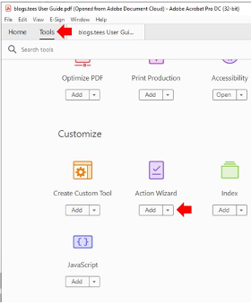
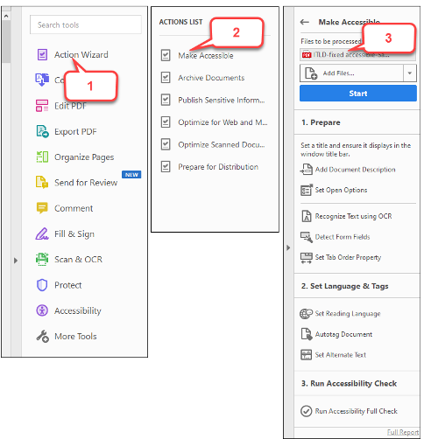
Using the Adobe Action Wizard Tool in Adobe Acrobat
Chose Tools > Action Wizard
From the Actions List, click Make Accessible
Select the files that you want to apply the Make Accessible action to. By default, the action runs on the document that's currently open. Select Add Files to select additional files or a folder to run the action on
Click Start
Follow guidelines on Adobe’s support site here

Slide 7
Optimizing for BlackBoard
Documents:
Word documents are preferred
Keep as DOCX file
Presentations:
Powerpoint presentations are preferred
Keep as PPTX file
Webpages:
Use links and hyperlink them to the original page
If pages are behind a paywall:
  Print (Control + P (Windows) OR Command + P (MacOS)
  Save as PDF
  Use Adobe Action Wizard on PDF
  Upload PDF to Blackboard

